Slide 1
Data Mining
Chapter 5
Association Analysis: Basic Concepts
Introduction to Data Mining, 2nd Edition
by
Tan, Steinbach, Karpatne, Kumar

Slide 2
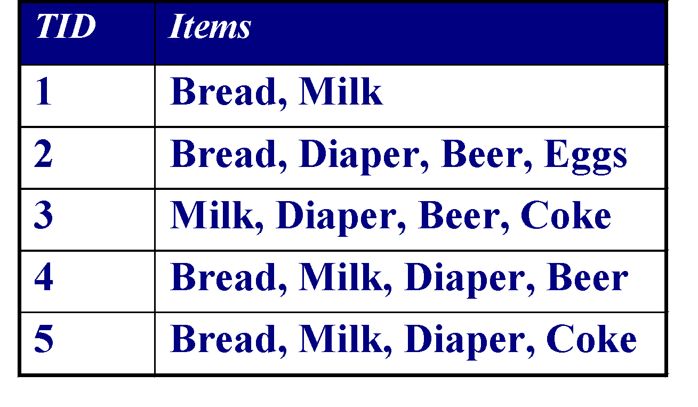
Association Rule Mining
Given a set of transactions, find rules that will predict the occurrence of an item based on the occurrences of other items in the transaction
Market-Basket transactions
Example of Association Rules
{Diaper} → {Beer}, {Milk, Bread} → {Eggs,Coke}, {Beer, Bread} → {Milk},
Implication means co-occurrence, not causality!

Slide 3
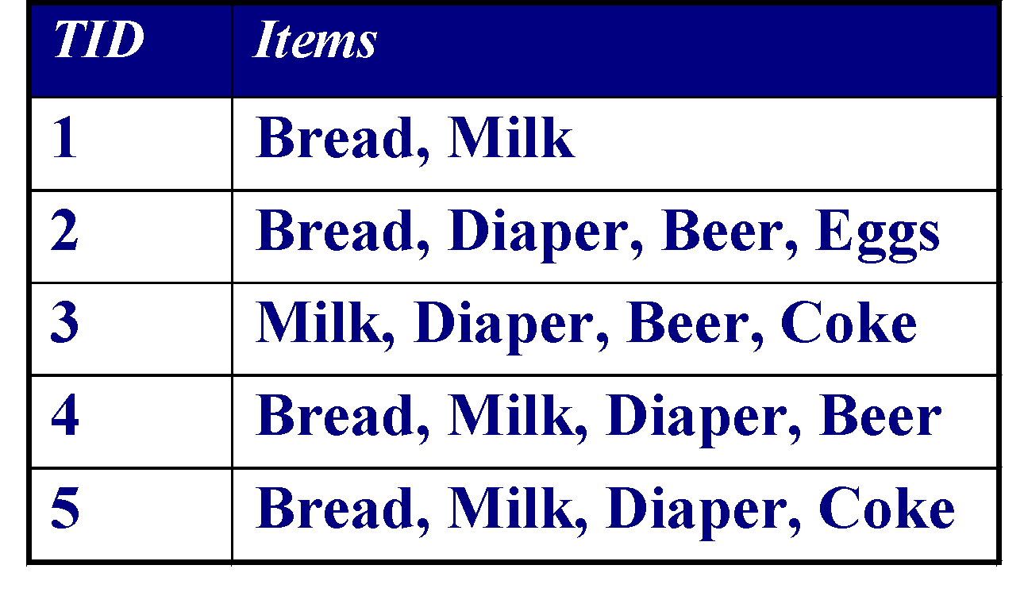
Definition: Frequent Itemset
Itemset
A collection of one or more items
Example: {Milk, Bread, Diaper}
k-itemset
An itemset that contains k items
Support count (σ)
Frequency of occurrence of an itemset
E.g. σ({Milk, Bread,Diaper}) = 2
Support
Fraction of transactions that contain an itemset
E.g. s({Milk, Bread, Diaper}) = 2/5
Frequent Itemset
An itemset whose support is greater than or equal to a minsup threshold

Slide 4

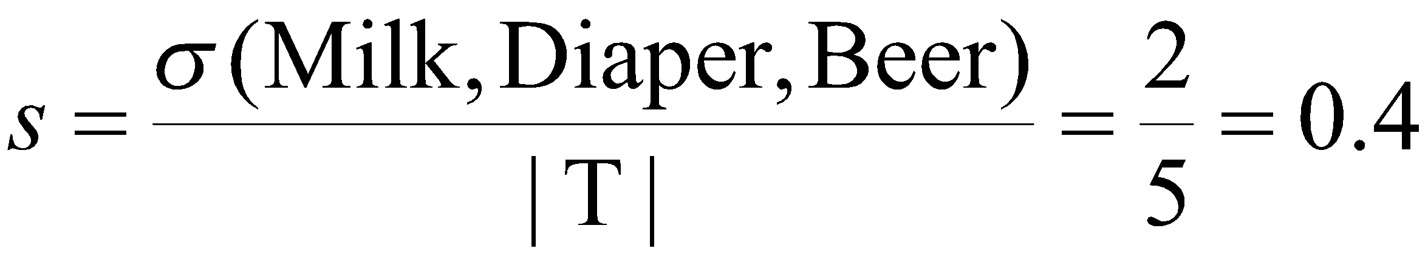
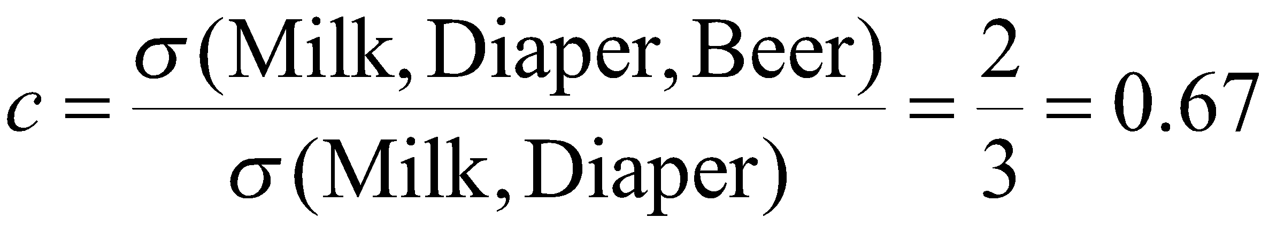
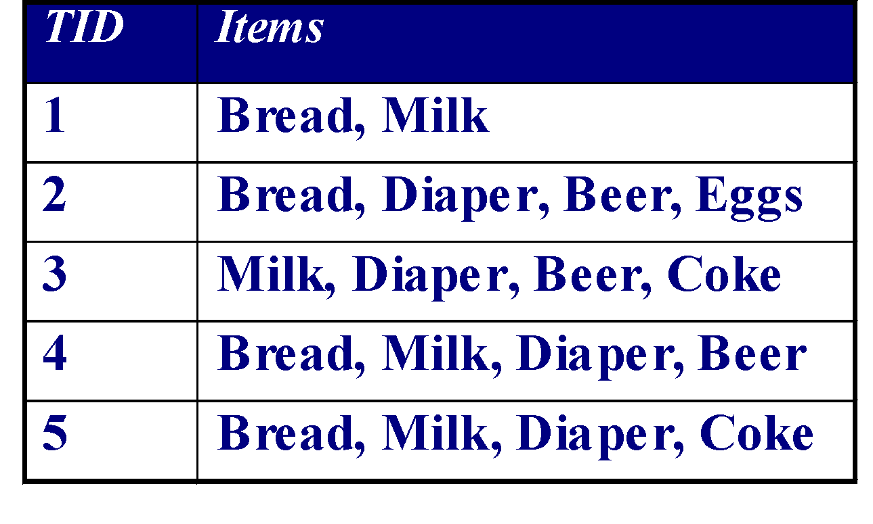
Definition: Association Rule
Association Rule
An implication expression of the form X → Y, where X and Y are itemsets
Example: {Milk, Diaper} → {Beer}
Rule Evaluation Metrics
Support (s)
Fraction of transactions that contain both X and Y
Confidence (c)
Measures how often items in Y appear in transactions that contain X
Example:

Slide 5
Association Rule Mining Task
Given a set of transactions T, the goal of association rule mining is to find all rules having
support ≥ minsup threshold
confidence ≥ minconf threshold
Brute-force approach:
List all possible association rules
Compute the support and confidence for each rule
Prune rules that fail the minsup and minconf thresholds
⇒ Computationally prohibitive!

Slide 6
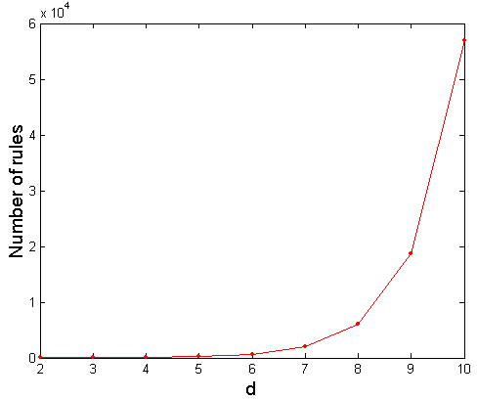
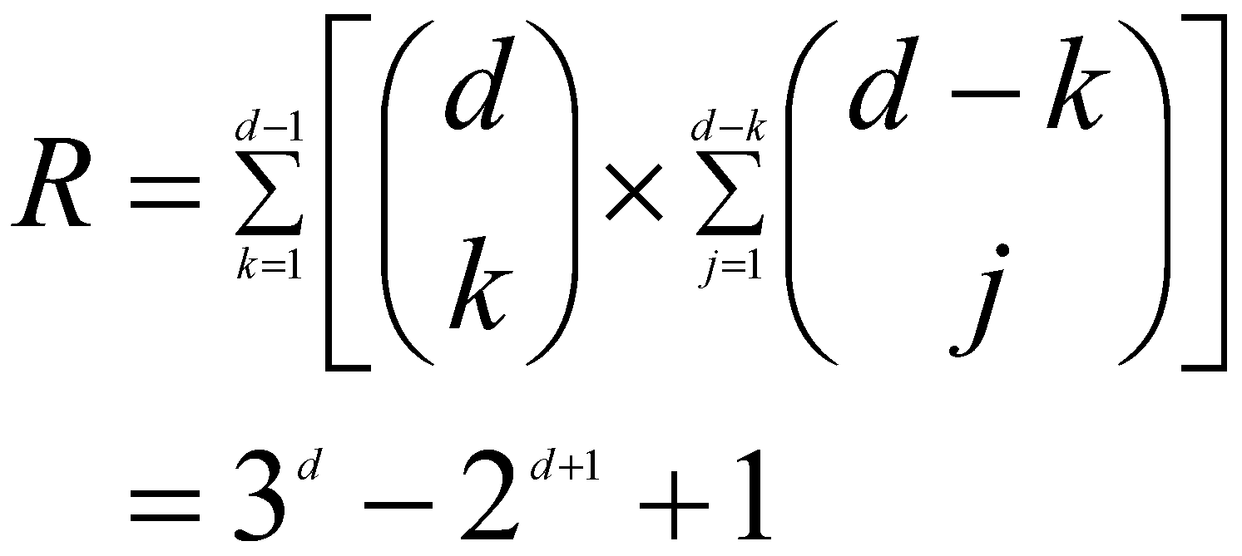
Computational Complexity
Given d unique items:
Total number of itemsets = 2^{d}
Total number of possible association rules:
If d=6, R = 602 rules

Slide 7
Mining Association Rules
Example of Rules:
{Milk,Diaper} → {Beer} (s=0.4, c=0.67) {Milk,Beer} → {Diaper} (s=0.4, c=1.0)
{Diaper,Beer} → {Milk} (s=0.4, c=0.67)
{Beer} → {Milk,Diaper} (s=0.4, c=0.67) {Diaper} → {Milk,Beer} (s=0.4, c=0.5)
{Milk} → {Diaper,Beer} (s=0.4, c=0.5)
Observations:
All the above rules are binary partitions of the same itemset: {Milk, Diaper, Beer}
Rules originating from the same itemset have identical support but can have different confidence
Thus, we may decouple the support and confidence requirements

Slide 8
Mining Association Rules
Two-step approach:
Frequent Itemset Generation
Generate all itemsets whose support ≥ minsup
Rule Generation
Generate high confidence rules from each frequent itemset, where each rule is a binary partitioning of a frequent itemset
Frequent itemset generation is still computationally expensive

Slide 9
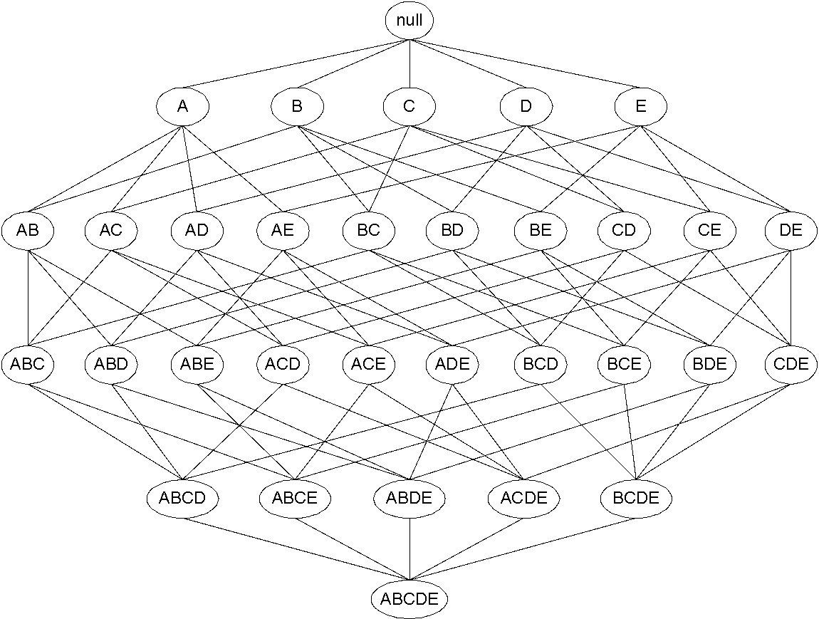
Frequent Itemset Generation
Given d items, there are 2^{d} possible candidate itemsets

Slide 10
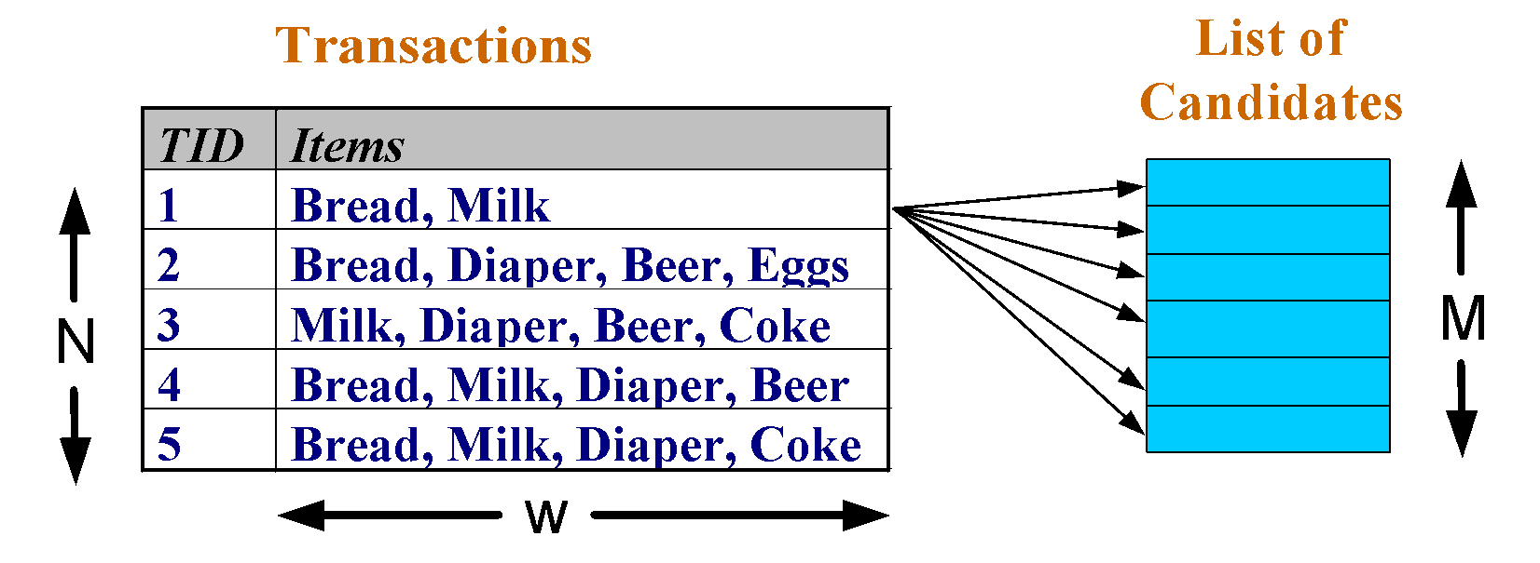
Frequent Itemset Generation
Brute-force approach:
Each itemset in the lattice is a candidate frequent itemset
Count the support of each candidate by scanning the database
Match each transaction against every candidate
Complexity ~ O(NMw) => Expensive since M = 2^{d} !!!

Slide 11
Frequent Itemset Generation Strategies
Reduce the number of candidates (M)
Complete search: M=2^{d}
Use pruning techniques to reduce M
Reduce the number of transactions (N)
Reduce size of N as the size of itemset increases
Used by DHP and vertical-based mining algorithms
Reduce the number of comparisons (NM)
Use efficient data structures to store the candidates or transactions
No need to match every candidate against every transaction

Slide 12
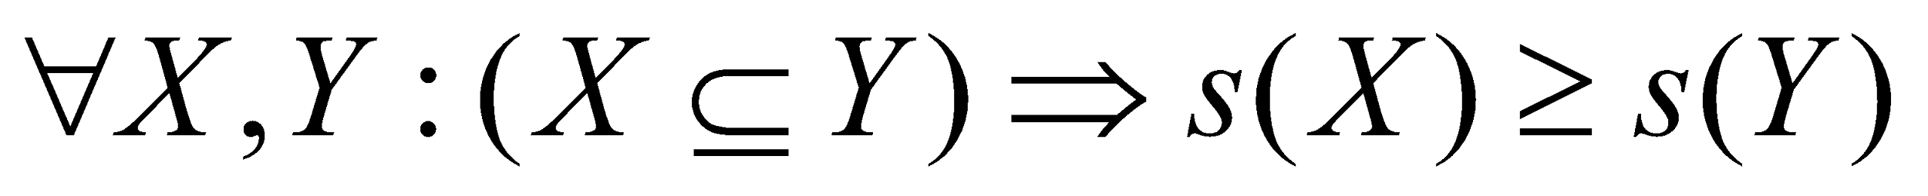
Reducing Number of Candidates
Apriori principle:
If an itemset is frequent, then all of its subsets must also be frequent
Apriori principle holds due to the following property of the support measure:
Support of an itemset never exceeds the support of its subsets
This is known as the anti-monotone property of support

Slide 13
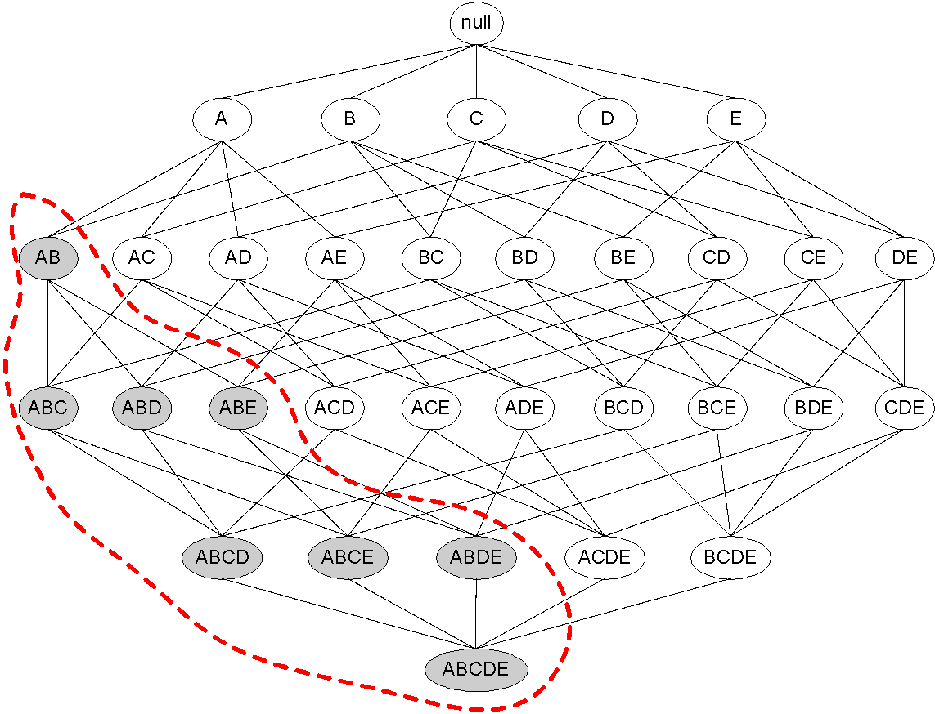
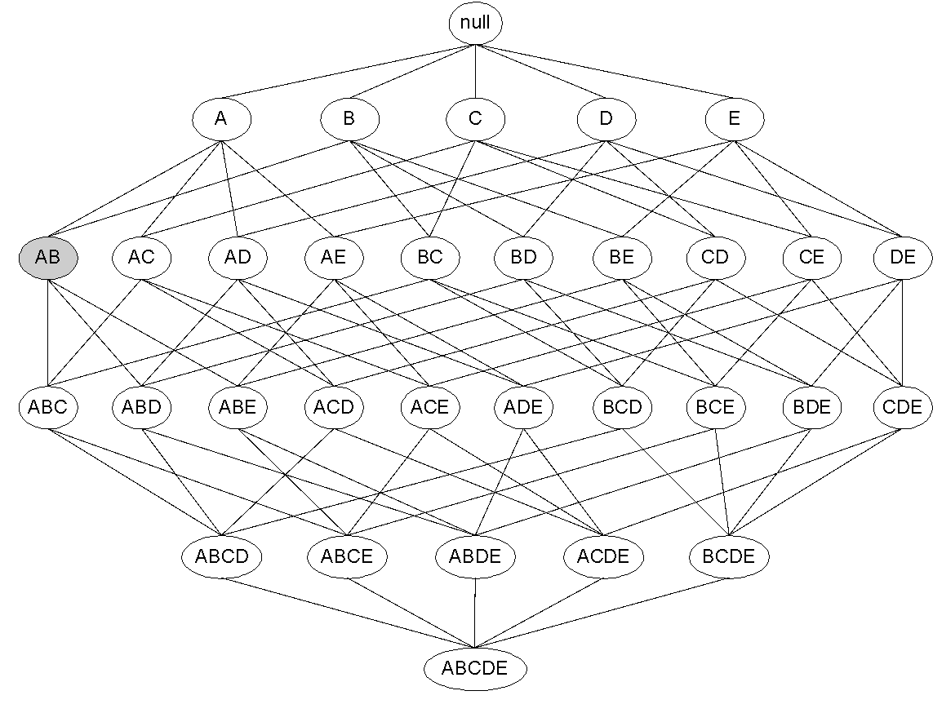
Illustrating Apriori Principle
Found to be Infrequent
Pruned supersets

Slide 14
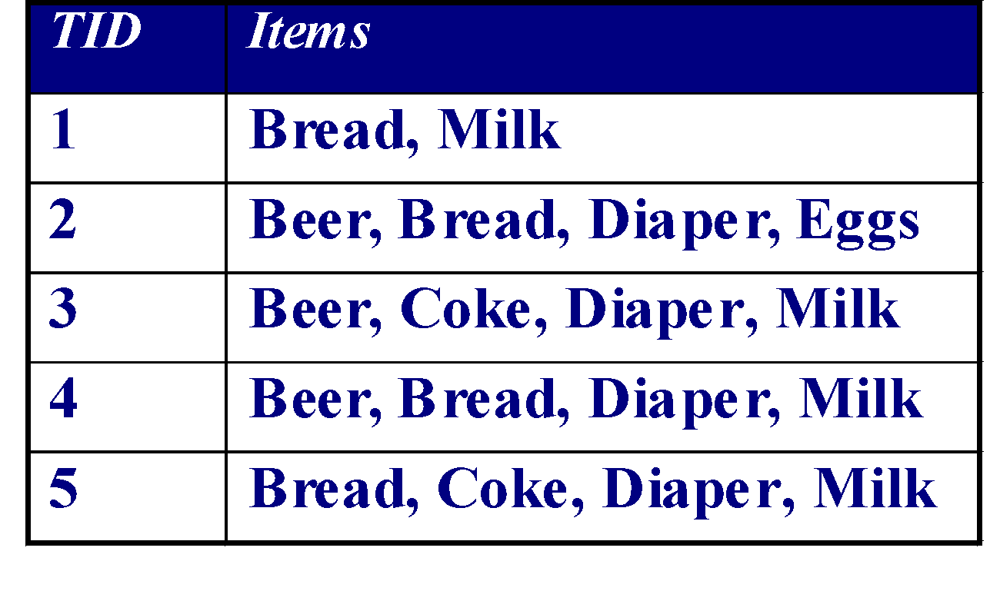
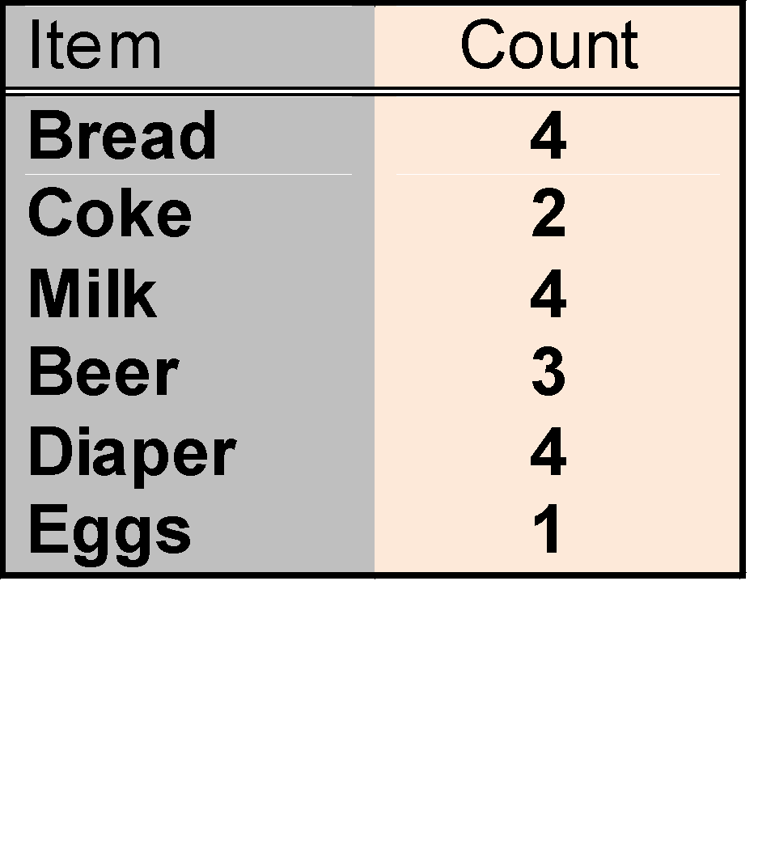
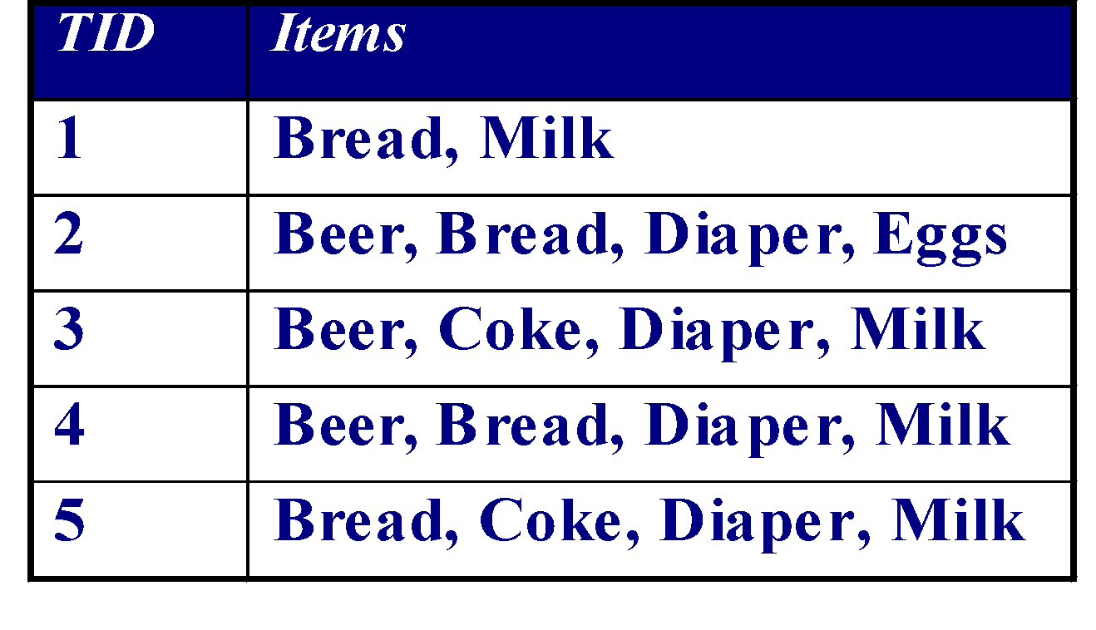
Illustrating Apriori Principle
Items (1-itemsets)
Minimum Support = 3
If every subset is considered,
⁶C₁ + ⁶C₂ + ⁶C₃
6 + 15 + 20 = 41
With support-based pruning,
6 + 6 + 4 = 16

Slide 15
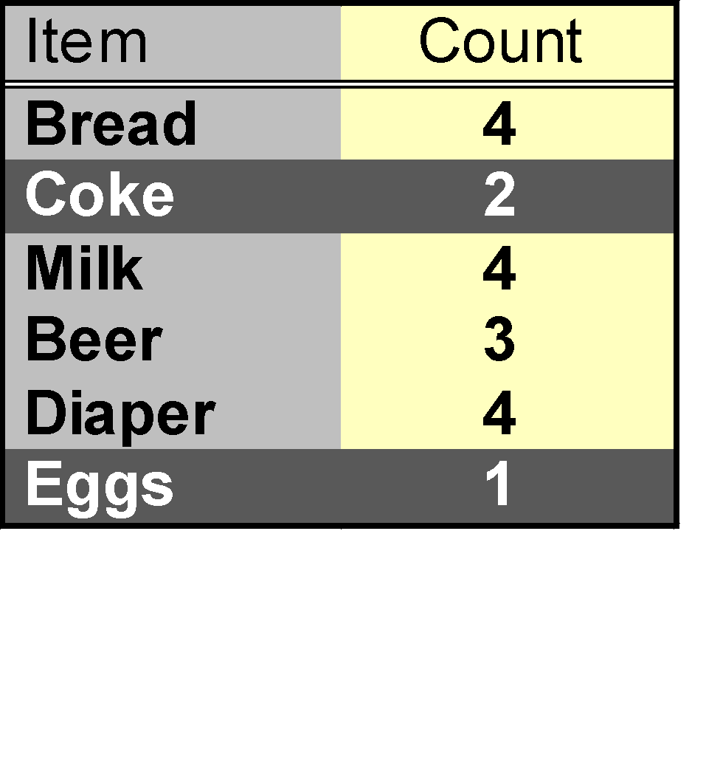
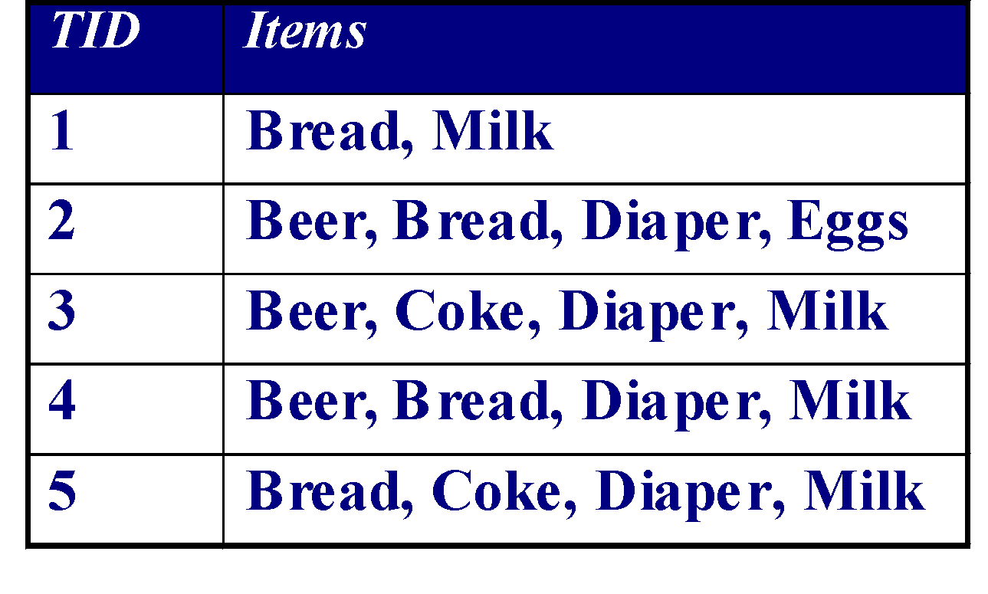
Illustrating Apriori Principle
Items (1-itemsets)
Minimum Support = 3
If every subset is considered,
⁶C₁ + ⁶C₂ + ⁶C₃
6 + 15 + 20 = 41
With support-based pruning,
6 + 6 + 4 = 16

Slide 16
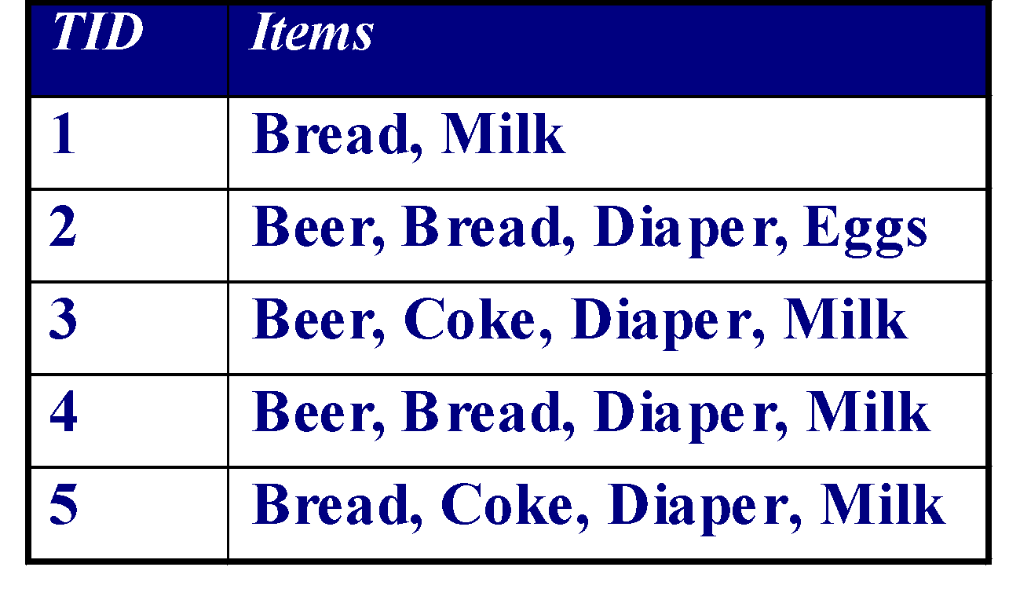
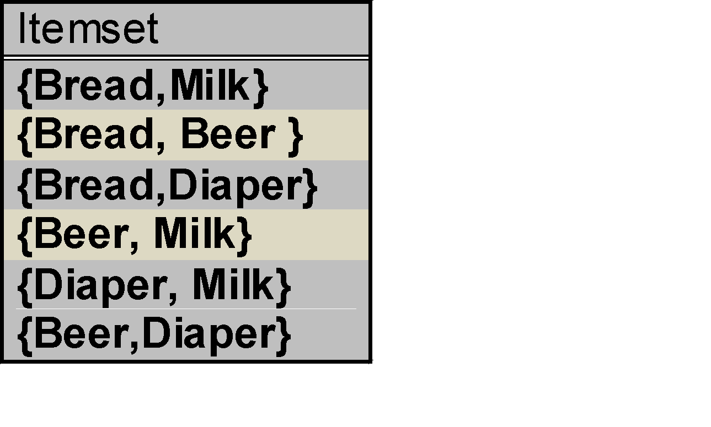
Illustrating Apriori Principle
Items (1-itemsets)
Pairs (2-itemsets)
(No need to generate candidates involving Coke or Eggs)
Minimum Support = 3
If every subset is considered,
⁶C₁ + ⁶C₂ + ⁶C₃
6 + 15 + 20 = 41
With support-based pruning,
6 + 6 + 4 = 16

Slide 17
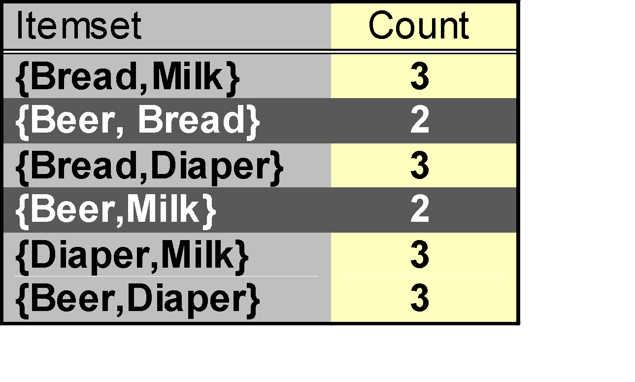
Illustrating Apriori Principle
Items (1-itemsets)
Pairs (2-itemsets)
(No need to generate candidates involving Coke or Eggs)
Minimum Support = 3
If every subset is considered,
⁶C₁ + ⁶C₂ + ⁶C₃
6 + 15 + 20 = 41
With support-based pruning,
6 + 6 + 4 = 16

Slide 18
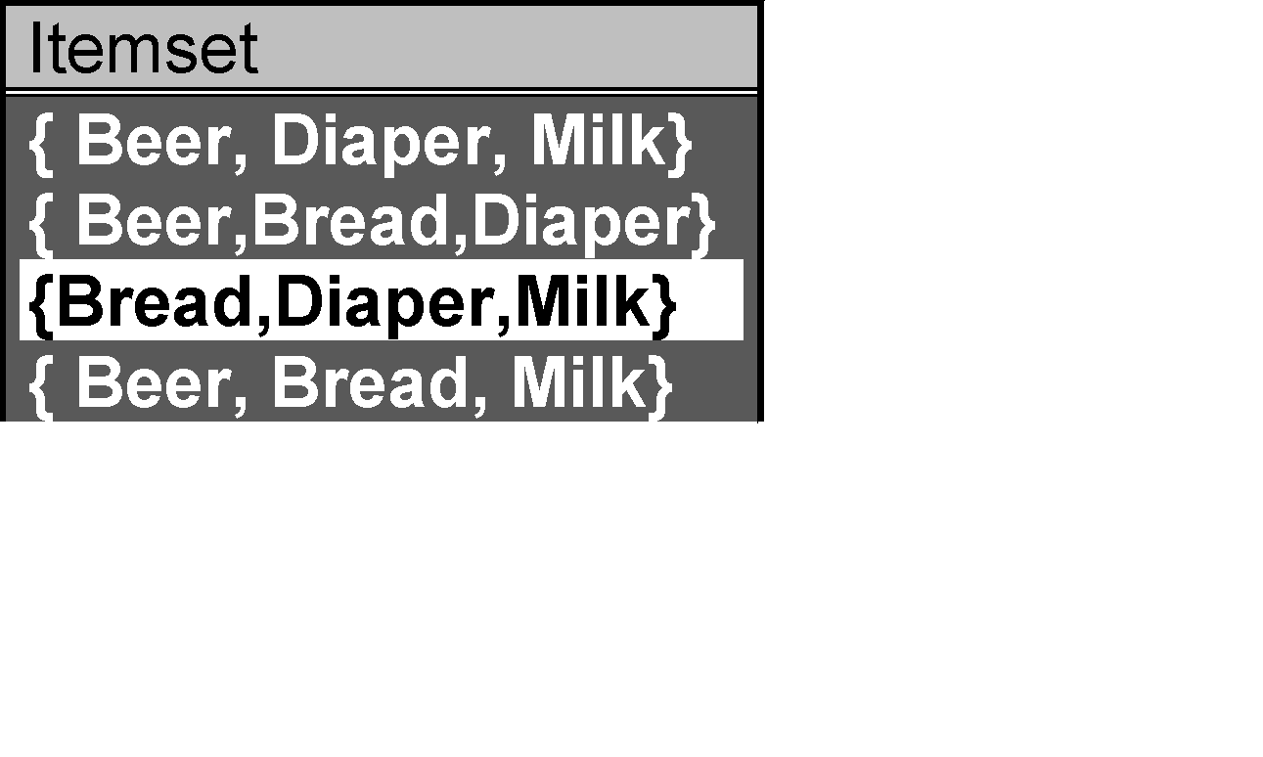
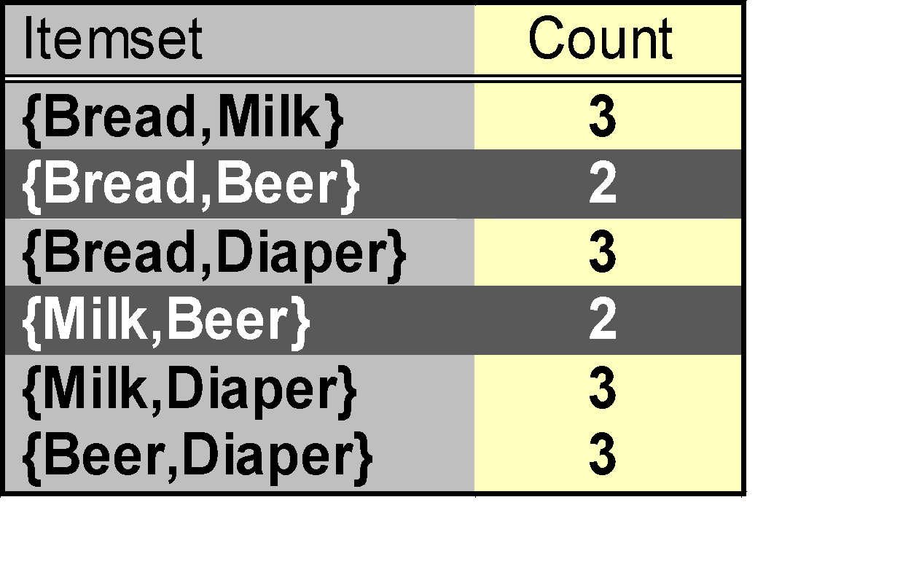
Illustrating Apriori Principle
Items (1-itemsets)
Pairs (2-itemsets)
(No need to generate candidates involving Coke or Eggs)
Minimum Support = 3
Triplets (3-itemsets)
If every subset is considered,
⁶C₁ + ⁶C₂ + ⁶C₃
6 + 15 + 20 = 41
With support-based pruning,
6 + 6 + 4 = 16
If every subset is considered,
⁶C₁ + ⁶C₂ + ⁶C₃
6 + 15 + 20 = 41
With support-based pruning,
6 + 6 + 4 = 16

Slide 19
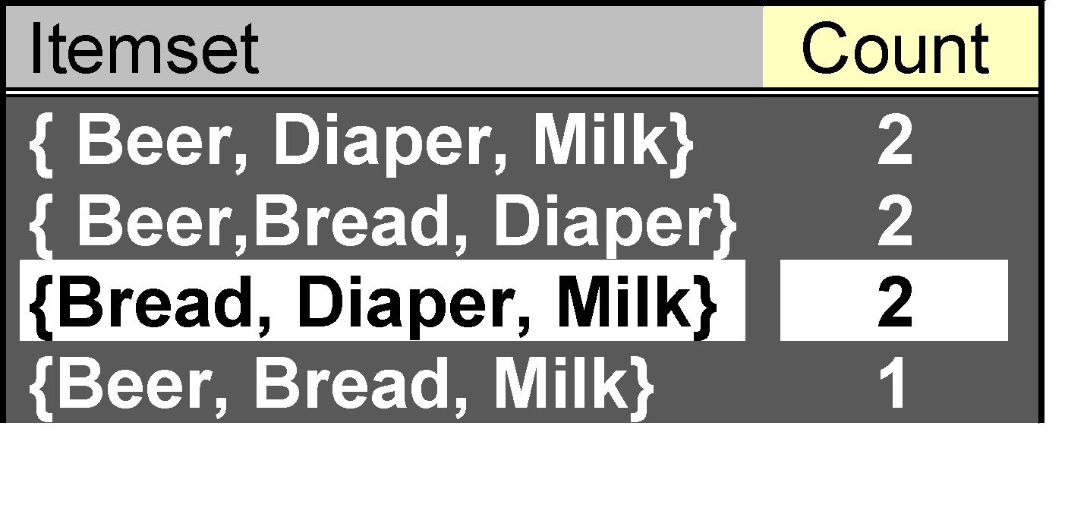
Illustrating Apriori Principle
Items (1-itemsets)
Pairs (2-itemsets)
(No need to generate candidates involving Coke or Eggs)
Minimum Support = 3
Triplets (3-itemsets)
If every subset is considered,
⁶C₁ + ⁶C₂ + ⁶C₃
6 + 15 + 20 = 41
With support-based pruning,
6 + 6 + 4 = 16

Slide 20
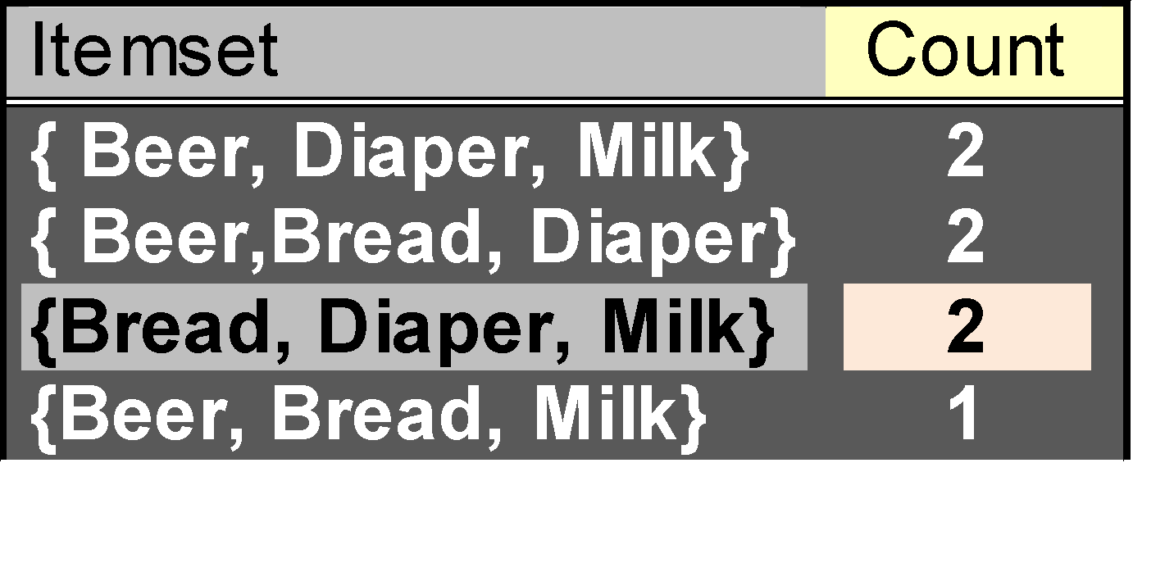
Illustrating Apriori Principle
Items (1-itemsets)
Pairs (2-itemsets)
(No need to generate candidates involving Coke or Eggs)
Minimum Support = 3
Triplets (3-itemsets)
If every subset is considered,
⁶C₁ + ⁶C₂ + ⁶C₃
6 + 15 + 20 = 41
With support-based pruning,
6 + 6 + 4 = 16
6 + 6 + 1 = 13

Slide 21
Apriori Algorithm
F_{k}: frequent k-itemsets
L_{k}: candidate k-itemsets
Algorithm
Let k=1
Generate F₁ = {frequent 1-itemsets}
Repeat until F_{k} is empty
Candidate Generation: Generate L_{k+1} from F_{k}
Candidate Pruning: Prune candidate itemsets in L_{k+1} containing subsets of length k that are infrequent
Support Counting: Count the support of each candidate in L_{k+1} by scanning the DB
Candidate Elimination: Eliminate candidates in L_{k+1} that are infrequent, leaving only those that are frequent => F_{k+1}

Slide 22
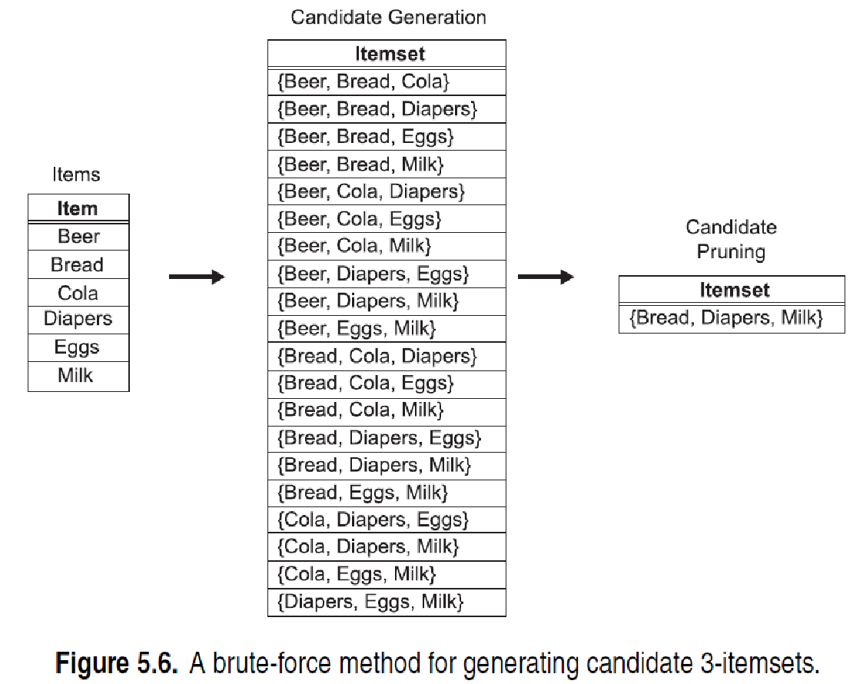
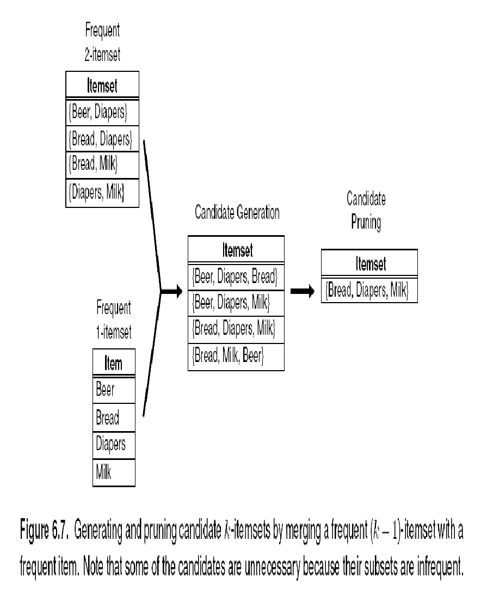
Candidate Generation: Brute-force method

Slide 23
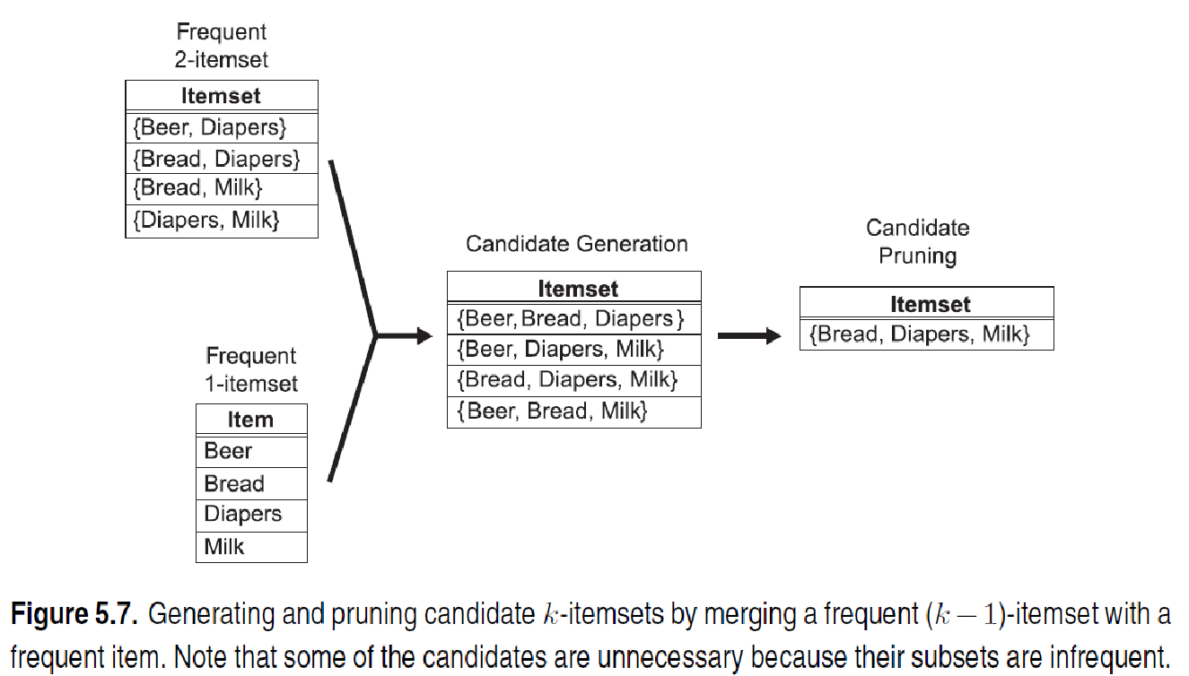
Candidate Generation: Merge Fk-1 and F1 itemsets

Slide 24
Candidate Generation: F_{k-1} x F_{k-1} Method
Merge two frequent (k-1)-itemsets if their first (k-2) items are identical
F₃ = {ABC,ABD,ABE,ACD,BCD,BDE,CDE}
Merge(ABC, ABD) = ABCD
Merge(ABC, ABE) = ABCE
Merge(ABD, ABE) = ABDE
Do not merge(ABD,ACD) because they share only prefix of length 1 instead of length 2

Slide 25
Candidate Pruning
Let F₃ = {ABC,ABD,ABE,ACD,BCD,BDE,CDE} be the set of frequent 3-itemsets
L₄ = {ABCD,ABCE,ABDE} is the set of candidate 4-itemsets generated (from previous slide)
Candidate pruning
Prune ABCE because ACE and BCE are infrequent
Prune ABDE because ADE is infrequent
After candidate pruning: L₄ = {ABCD}

Slide 26
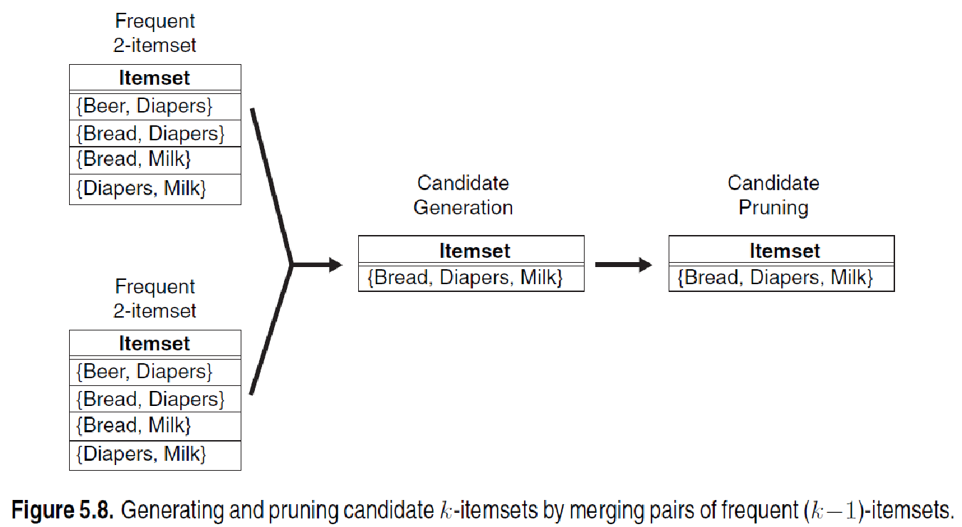
Candidate Generation: Fk-1 x Fk-1 Method

Slide 27
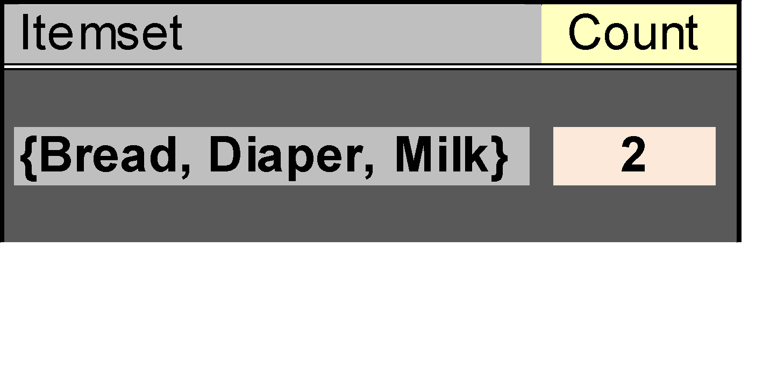
Illustrating Apriori Principle
Items (1-itemsets)
Pairs (2-itemsets)
(No need to generate candidates involving Coke or Eggs)
Minimum Support = 3
Triplets (3-itemsets)
If every subset is considered,
⁶C₁ + ⁶C₂ + ⁶C₃
6 + 15 + 20 = 41
With support-based pruning,
6 + 6 + 1 = 13
Use of F_{k-1}xF_{k-1} method for candidate generation results in
only one 3-itemset. This is eliminated after the support counting step.

Slide 28
Alternate F_{k-1} x F_{k-1} Method
Merge two frequent (k-1)-itemsets if the last (k-2) items of the first one is identical to the first (k-2) items of the second.
F₃ = {ABC,ABD,ABE,ACD,BCD,BDE,CDE}
Merge(ABC, BCD) = ABCD
Merge(ABD, BDE) = ABDE
Merge(ACD, CDE) = ACDE
Merge(BCD, CDE) = BCDE

Slide 29
Candidate Pruning for Alternate F_{k-1} x F_{k-1} Method
Let F₃ = {ABC,ABD,ABE,ACD,BCD,BDE,CDE} be the set of frequent 3-itemsets
L₄ = {ABCD,ABDE,ACDE,BCDE} is the set of candidate 4-itemsets generated (from previous slide)
Candidate pruning
Prune ABDE because ADE is infrequent
Prune ACDE because ACE and ADE are infrequent
Prune BCDE because BCE
After candidate pruning: L₄ = {ABCD}

Slide 30
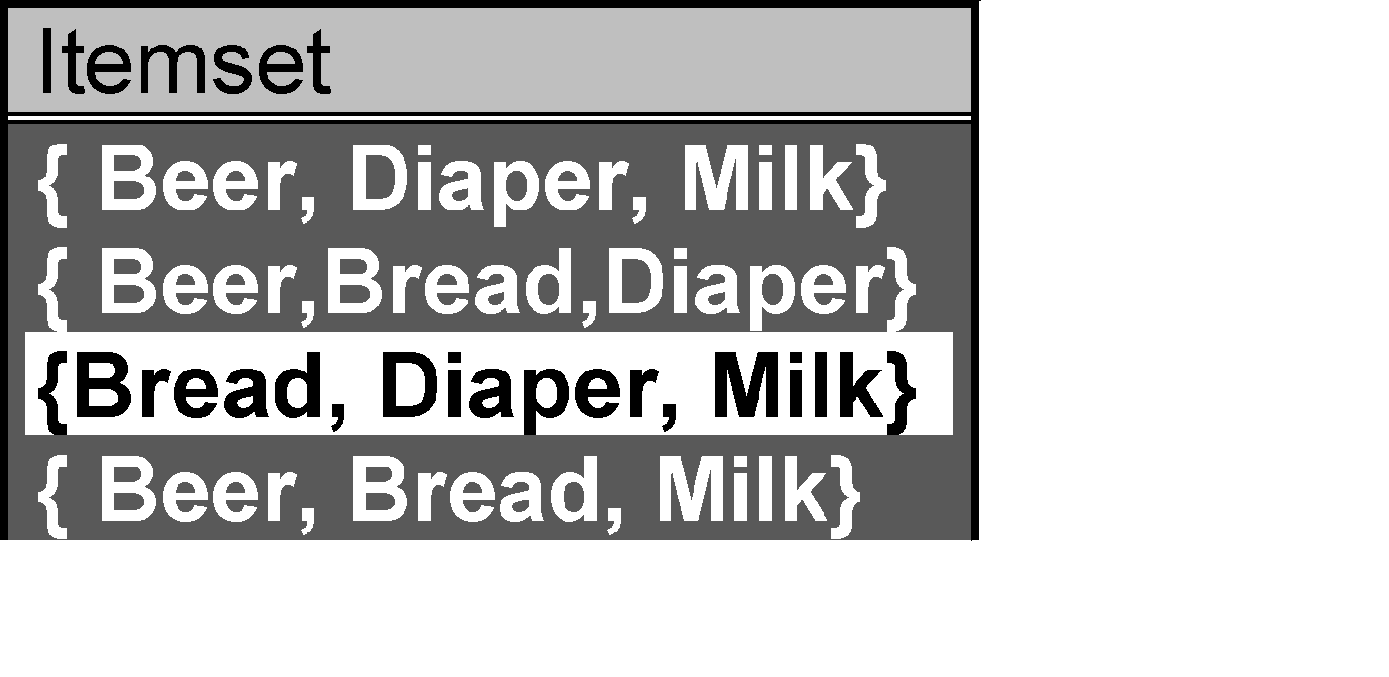
Support Counting of Candidate Itemsets
Scan the database of transactions to determine the support of each candidate itemset
Must match every candidate itemset against every transaction, which is an expensive operation

Slide 31
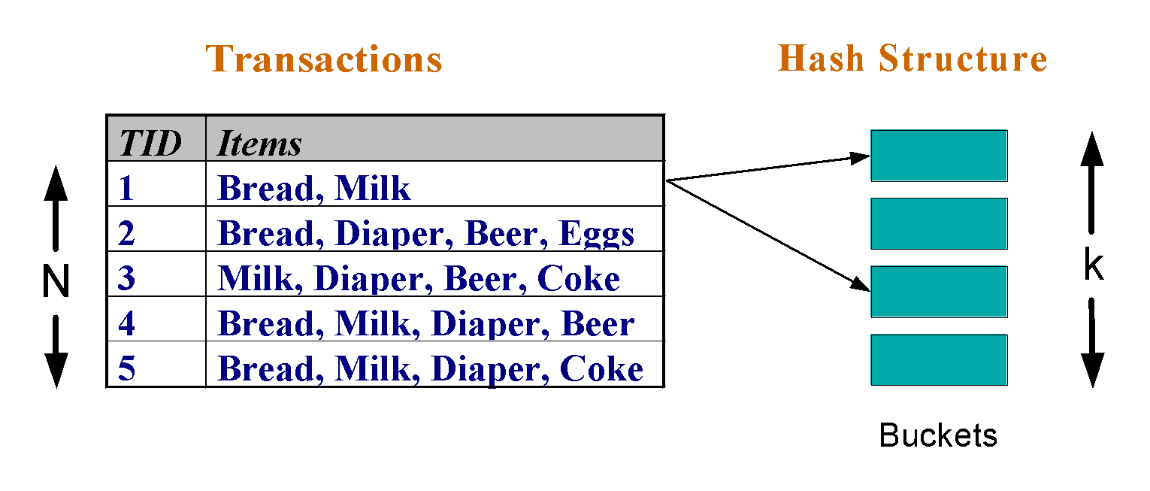
Support Counting of Candidate Itemsets
To reduce number of comparisons, store the candidate itemsets in a hash structure
Instead of matching each transaction against every candidate, match it against candidates contained in the hashed buckets

Slide 32
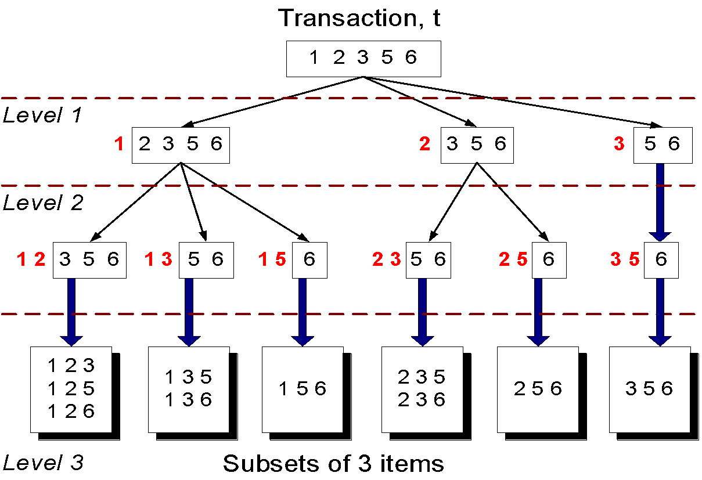
Support Counting: An Example
Suppose you have 15 candidate itemsets of length 3:
{1 4 5}, {1 2 4}, {4 5 7}, {1 2 5}, {4 5 8}, {1 5 9}, {1 3 6}, {2 3 4}, {5 6 7}, {3 4 5}, {3 5 6}, {3 5 7}, {6 8 9}, {3 6 7}, {3 6 8}
How many of these itemsets are supported by transaction (1,2,3,5,6)?

Slide 33
Support Counting Using a Hash Tree
Suppose you have 15 candidate itemsets of length 3:
{1 4 5}, {1 2 4}, {4 5 7}, {1 2 5}, {4 5 8}, {1 5 9}, {1 3 6}, {2 3 4}, {5 6 7}, {3 4 5}, {3 5 6}, {3 5 7}, {6 8 9}, {3 6 7}, {3 6 8}
You need:
Hash function
Max leaf size: max number of itemsets stored in a leaf node (if number of candidate itemsets exceeds max leaf size, split the node)
Hash function
2 3 4
5 6 7
3,6,9
1,4,7
1 4 5
3 4 5
3 5 6
3 5 7
6 8 9
3 6 7
3 6 8
1 3 6
2,5,8
1 2 4
4 5 7
1 2 5
4 5 8
1 5 9

Slide 34
Support Counting Using a Hash Tree
Hash Function
Candidate Hash Tree
1,4,7
3,6,9
2,5,8
2 3 4
5 6 7
1 4 5
1 3 6
3 4 5
3 5 6
3 6 7
Hash on 1, 4 or 7
3 5 7
3 6 8
1 2 4
1 5 9
6 8 9
1 2 5
4 5 7
4 5 8

Slide 35
Support Counting Using a Hash Tree
Hash Function
Candidate Hash Tree
1,4,7
3,6,9
2,5,8
2 3 4
5 6 7
1 4 5
1 3 6
3 4 5
3 5 6
3 6 7
Hash on 2, 5 or 8
3 5 7
3 6 8
1 2 4
1 5 9
6 8 9
1 2 5
4 5 7
4 5 8

Slide 36
Support Counting Using a Hash Tree
Hash Function
Candidate Hash Tree
1,4,7
3,6,9
2,5,8
2 3 4
5 6 7
1 4 5
1 3 6
3 4 5
3 5 6
3 6 7
Hash on 3, 6 or 9
3 5 7
3 6 8
1 2 4
1 5 9
6 8 9
1 2 5
4 5 7
4 5 8

Slide 37
Support Counting Using a Hash Tree
1 2 3 5 6
transaction
Hash Function
1 +
2 3 5 6
2 +
3 5 6
1,4,7
3,6,9
3 +
5 6
2,5,8
2 3 4
5 6 7
1 4 5
1 3 6
3 4 5
3 5 6
3 6 7
3 5 7
3 6 8
1 2 4
1 2 5
1 5 9
6 8 9
4 5 7
4 5 8

Slide 38
Support Counting Using a Hash Tree
1 2 3 5 6
transaction
Hash Function
1 +
2 3 5 6
2 +
3 5 6
1,4,7
3,6,9
1 2 +
3 5 6
3 +
5 6
2,5,8
1 3 +
5 6
2 3 4
1 5 +
6
5 6 7
1 4 5
1 3 6
3 4 5
3 5 6
3 6 7
3 5 7
3 6 8
1 2 4
1 2 5
1 5 9
6 8 9
4 5 7
4 5 8

Slide 39
Support Counting Using a Hash Tree
1 2 3 5 6
transaction
Hash Function
1 +
2 3 5 6
2 +
3 5 6
1,4,7
3,6,9
1 2 +
3 5 6
3 +
5 6
2,5,8
1 3 +
5 6
2 3 4
1 5 +
6
5 6 7
1 4 5
1 3 6
3 4 5
3 5 6
3 6 7
3 5 7
3 6 8
1 2 4
1 2 5
1 5 9
6 8 9
4 5 7
4 5 8
Match transaction against 11 out of 15 candidates

Slide 40
Rule Generation
Given a frequent itemset L, find all non-empty subsets f ⊂ L such that f → L – f satisfies the minimum confidence requirement
If {A,B,C,D} is a frequent itemset, candidate rules:
ABC →D, ABD →C, ACD →B, BCD →A, A →BCD, B →ACD, C →ABD, D →ABC AB →CD, AC → BD, AD → BC, BC →AD, BD →AC, CD →AB,
If |L| = k, then there are 2^{k} – 2 candidate association rules (ignoring L → ∅ and ∅ → L)

Slide 41
Rule Generation
In general, confidence does not have an anti-monotone property
c(ABC →D) can be larger or smaller than c(AB →D)
But confidence of rules generated from the same itemset has an anti-monotone property
E.g., Suppose {A,B,C,D} is a frequent 4-itemset: c(ABC → D) ≥ c(AB → CD) ≥ c(A → BCD)
Confidence is anti-monotone w.r.t. number of items on the RHS of the rule

Slide 42
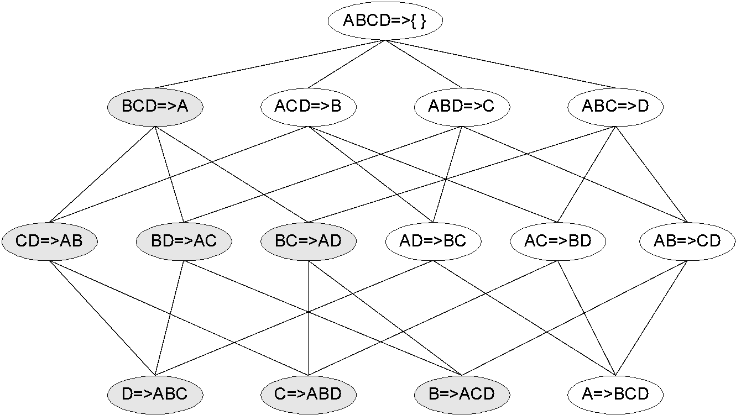
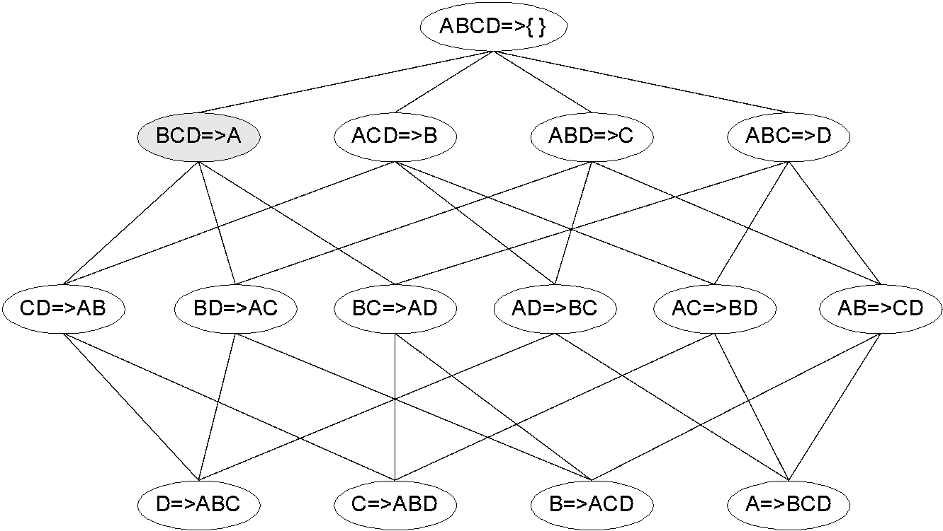
Rule Generation for Apriori Algorithm
Lattice of rules
Low Confidence Rule
Pruned Rules

Slide 43
Association Analysis: Basic Concepts and Algorithms
Algorithms and Complexity

Slide 44
Factors Affecting Complexity of Apriori
Choice of minimum support threshold
Dimensionality (number of items) of the data set
Size of database
Average transaction width

Slide 45
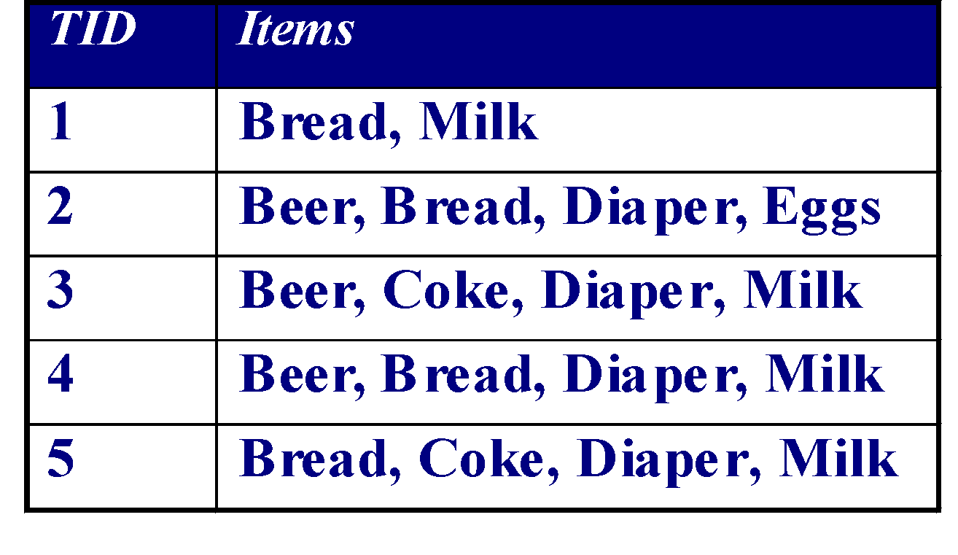
Factors Affecting Complexity of Apriori
Choice of minimum support threshold
lowering support threshold results in more frequent itemsets
this may increase number of candidates and max length of frequent itemsets
Dimensionality (number of items) of the data set
Size of database
Average transaction width

Slide 46
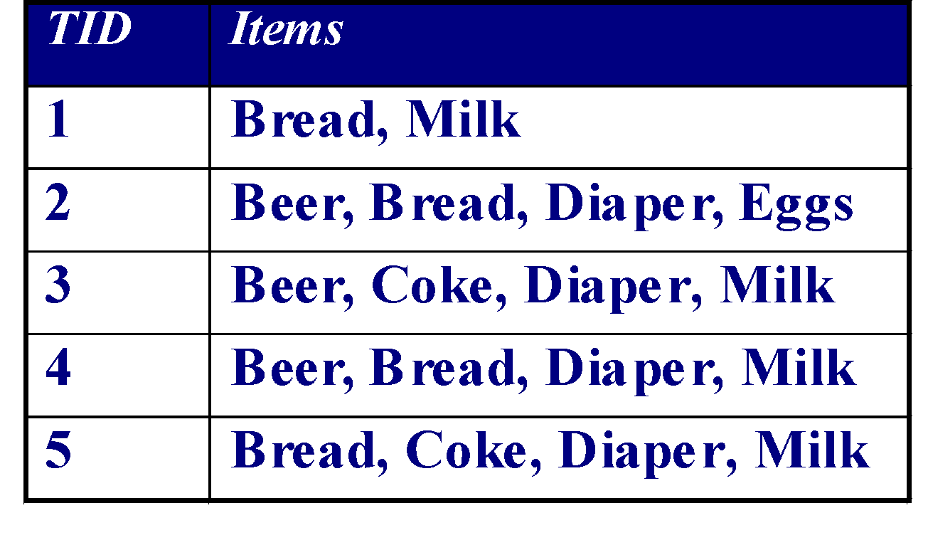
Impact of Support Based Pruning
Items (1-itemsets)
Minimum Support = 3
Minimum Support = 2
If every subset is considered,
⁶C₁ + ⁶C₂ + ⁶C₃
6 + 15 + 20 = 41
With support-based pruning,
6 + 6 + 4 = 16
If every subset is considered,
⁶C₁ + ⁶C₂ + ⁶C₃ + ⁶C₄
6 + 15 + 20 +15 = 56

Slide 47
Factors Affecting Complexity of Apriori
Choice of minimum support threshold
lowering support threshold results in more frequent itemsets
this may increase number of candidates and max length of frequent itemsets
Dimensionality (number of items) of the data set
More space is needed to store support count of itemsets
if number of frequent itemsets also increases, both computation and I/O costs may also increase
Size of database
Average transaction width

Slide 48
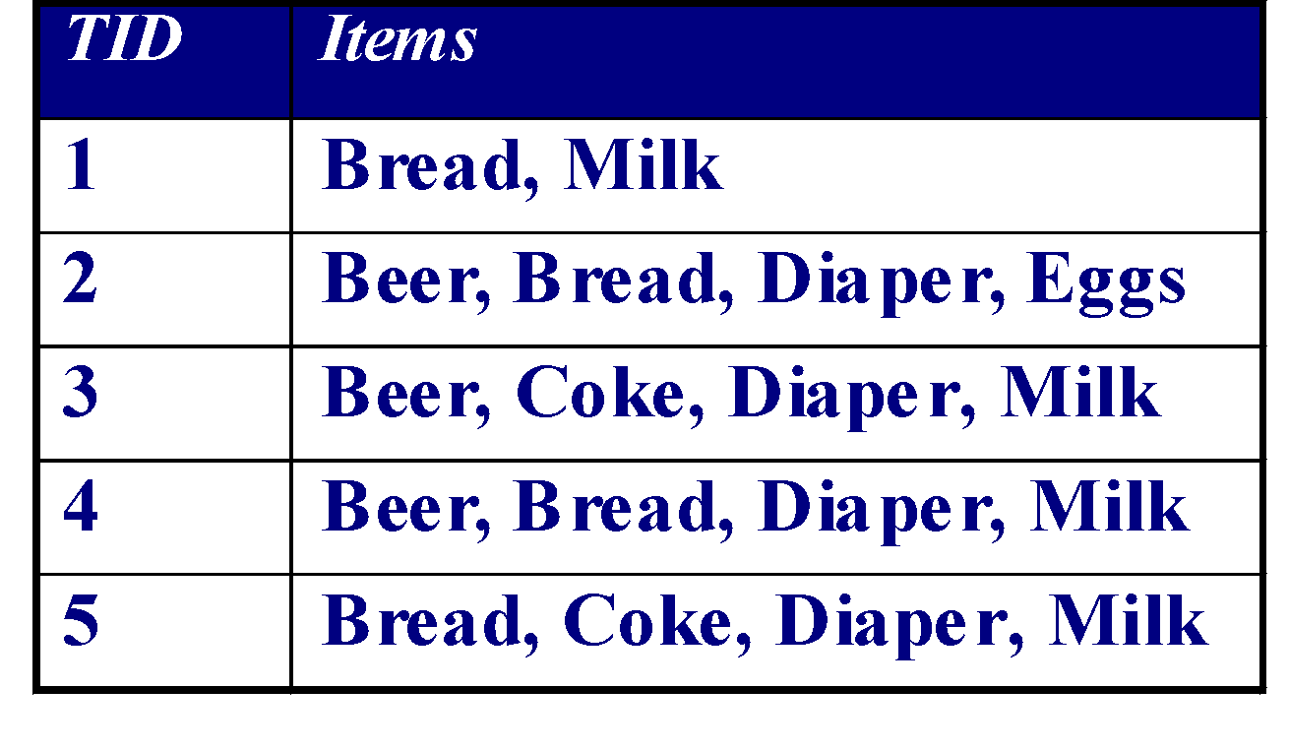
Factors Affecting Complexity of Apriori
Choice of minimum support threshold
lowering support threshold results in more frequent itemsets
this may increase number of candidates and max length of frequent itemsets
Dimensionality (number of items) of the data set
More space is needed to store support count of itemsets
if number of frequent itemsets also increases, both computation and I/O costs may also increase
Size of database
run time of algorithm increases with number of transactions
Average transaction width

Slide 49
Factors Affecting Complexity of Apriori
Choice of minimum support threshold
lowering support threshold results in more frequent itemsets
this may increase number of candidates and max length of frequent itemsets
Dimensionality (number of items) of the data set
More space is needed to store support count of itemsets
if number of frequent itemsets also increases, both computation and I/O costs may also increase
Size of database
run time of algorithm increases with number of transactions
Average transaction width
transaction width increases the max length of frequent itemsets
number of subsets in a transaction increases with its width, increasing computation time for support counting

Slide 50
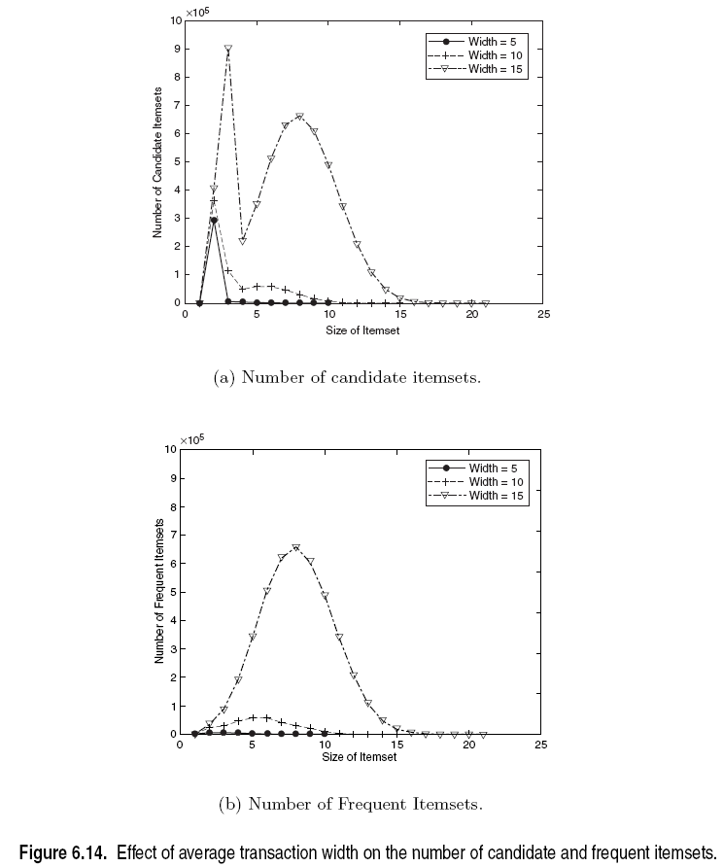
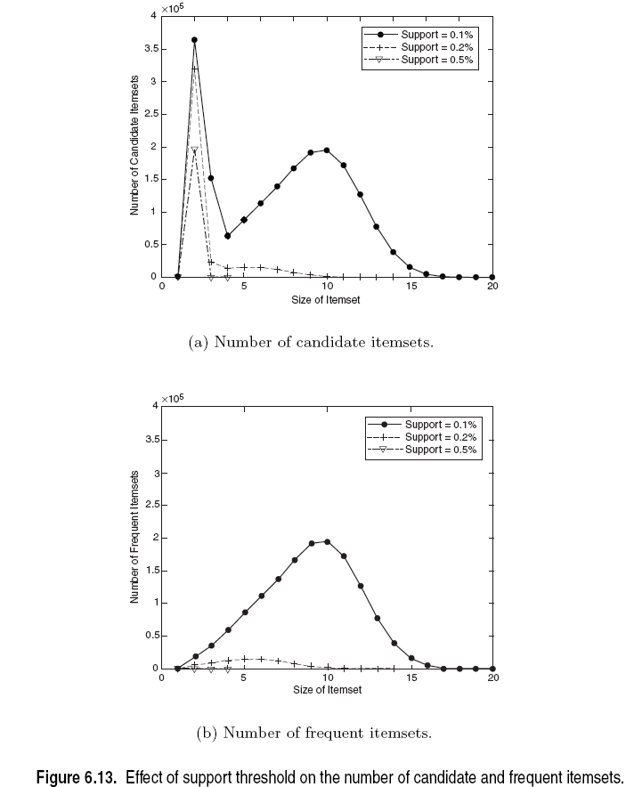
Factors Affecting Complexity of Apriori

Slide 51
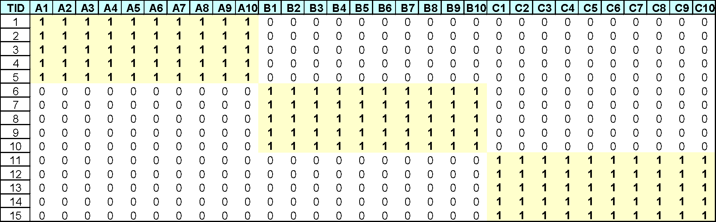
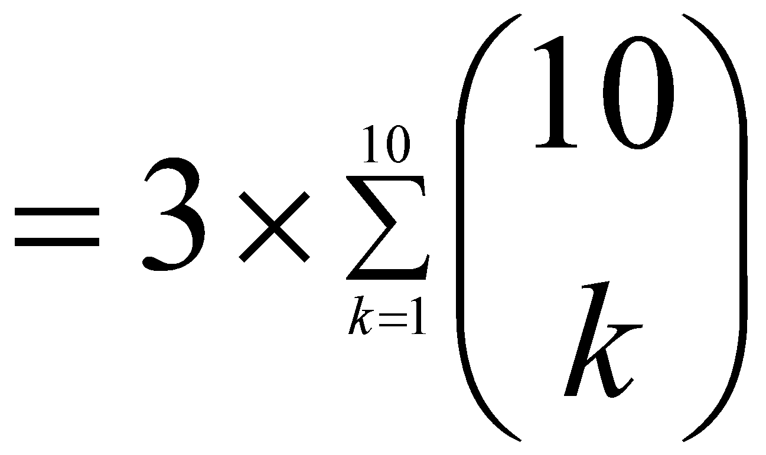
Compact Representation of Frequent Itemsets
Some frequent itemsets are redundant because their supersets are also frequent
Consider the following data set. Assume support threshold =5
Number of frequent itemsets
Need a compact representation

Slide 52
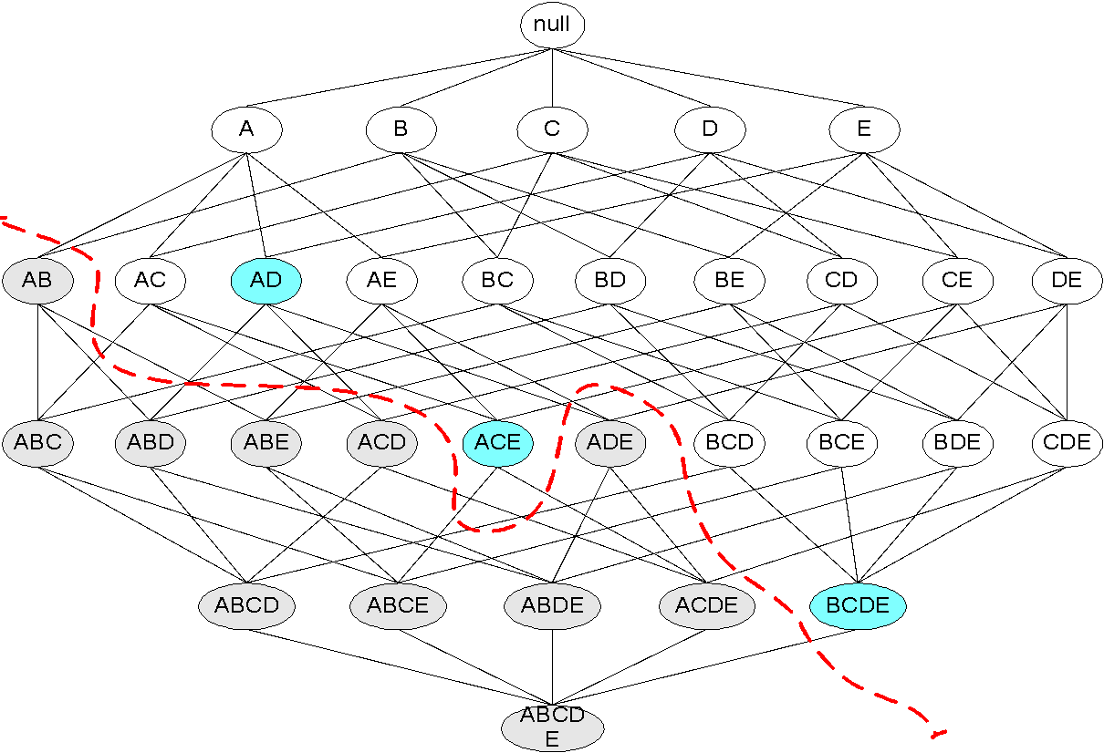
Maximal Frequent Itemset
An itemset is maximal frequent if it is frequent and none of its immediate supersets is frequent
Maximal Itemsets
Infrequent Itemsets
Border

Slide 53
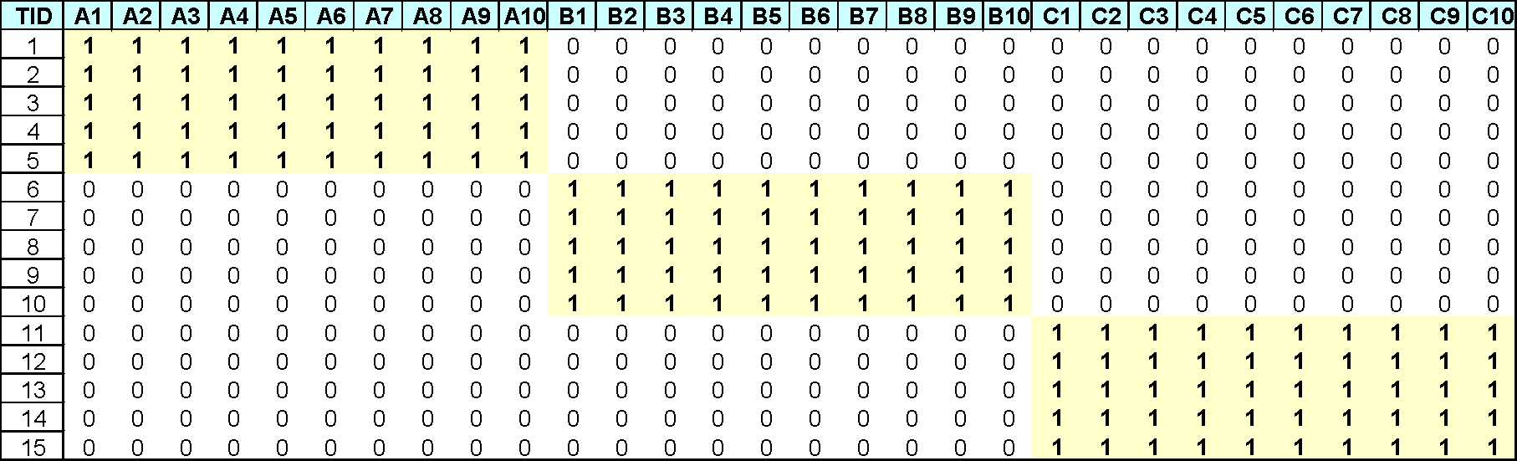
What are the Maximal Frequent Itemsets in this Data?
Minimum support threshold = 5
(A1-A10)
(B1-B10)
(C1-C10)

Slide 54
An illustrative example
Items
 | A | B | C | D | E | F | G | H | I | J
1
2
3
4
5
6
7
8
9
10
Support threshold (by count) : 5
Frequent itemsets: ?
Maximal itemsets: ?
Transactions

Slide 55
An illustrative example
Items
 | A | B | C | D | E | F | G | H | I | J
1
2
3
4
5
6
7
8
9
10
Support threshold (by count) : 5
Frequent itemsets: {F}
Maximal itemsets: {F}
Support threshold (by count): 4
Frequent itemsets: ?
Maximal itemsets: ?
Transactions

Slide 56
An illustrative example
Items
 | A | B | C | D | E | F | G | H | I | J
1
2
3
4
5
6
7
8
9
10
Support threshold (by count) : 5
Frequent itemsets: {F}
Maximal itemsets: {F}
Support threshold (by count): 4
Frequent itemsets: {E}, {F}, {E,F}, {J}
Maximal itemsets: {E,F}, {J}
Support threshold (by count): 3
Frequent itemsets: ?
Maximal itemsets: ?
Transactions

Slide 57
An illustrative example
Items
 | A | B | C | D | E | F | G | H | I | J
1
2
3
4
5
6
7
8
9
10
Support threshold (by count) : 5
Frequent itemsets: {F}
Maximal itemsets: {F}
Support threshold (by count): 4
Frequent itemsets: {E}, {F}, {E,F}, {J}
Maximal itemsets: {E,F}, {J}
Support threshold (by count): 3
Frequent itemsets:
All subsets of {C,D,E,F} + {J}
Maximal itemsets:
{C,D,E,F}, {J}
Transactions

Slide 58
Another illustrative example
Items
 | A | B | C | D | E | F | G | H | I | J
1
2
3
4
5
6
7
8
9
10
Support threshold (by count) : 5
Maximal itemsets: {A}, {B}, {C}
Support threshold (by count): 4
Maximal itemsets: {A,B}, {A,C},{B,C}
Support threshold (by count): 3
Maximal itemsets: {A,B,C}
Transactions

Slide 59
Closed Itemset
An itemset X is closed if none of its immediate supersets has the same support as the itemset X.
X is not closed if at least one of its immediate supersets has support count as X.

Slide 60
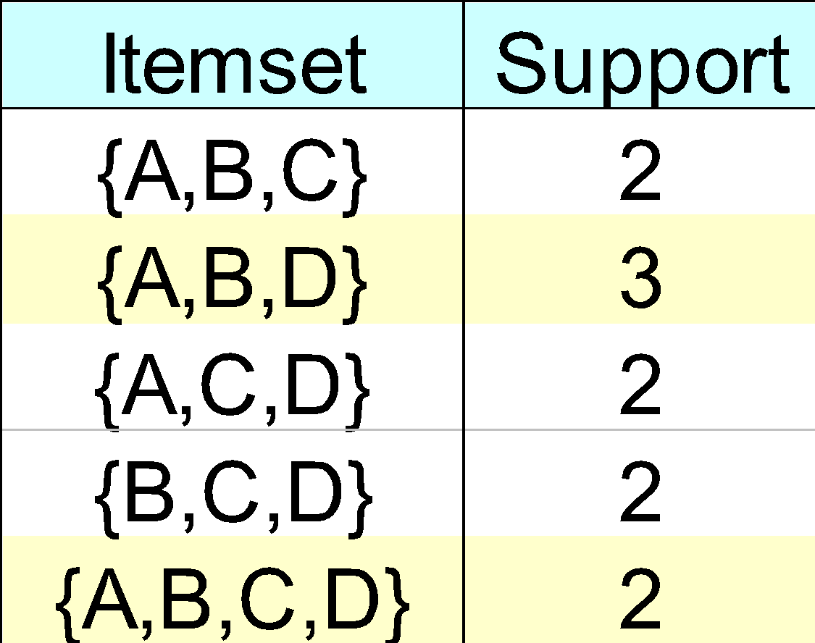
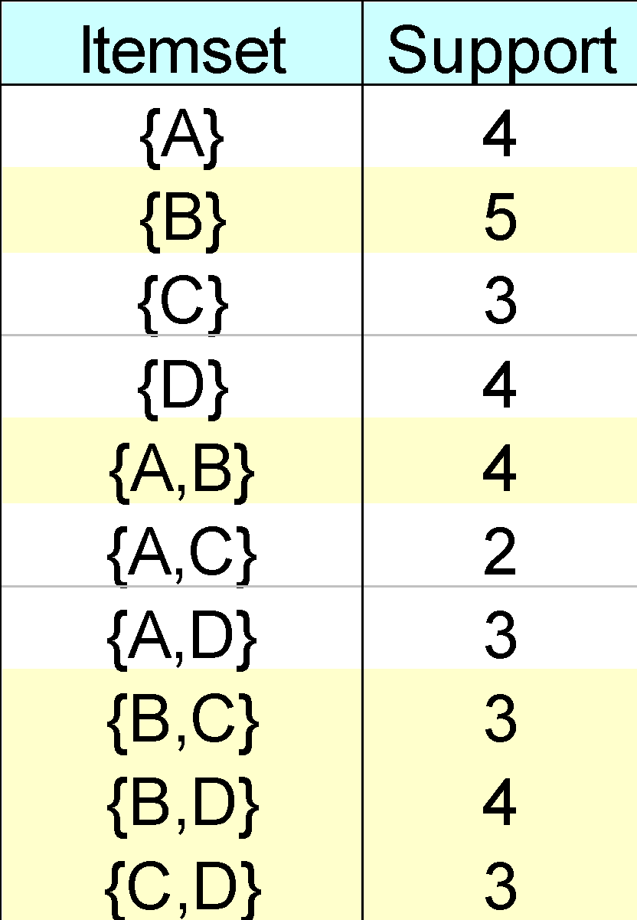
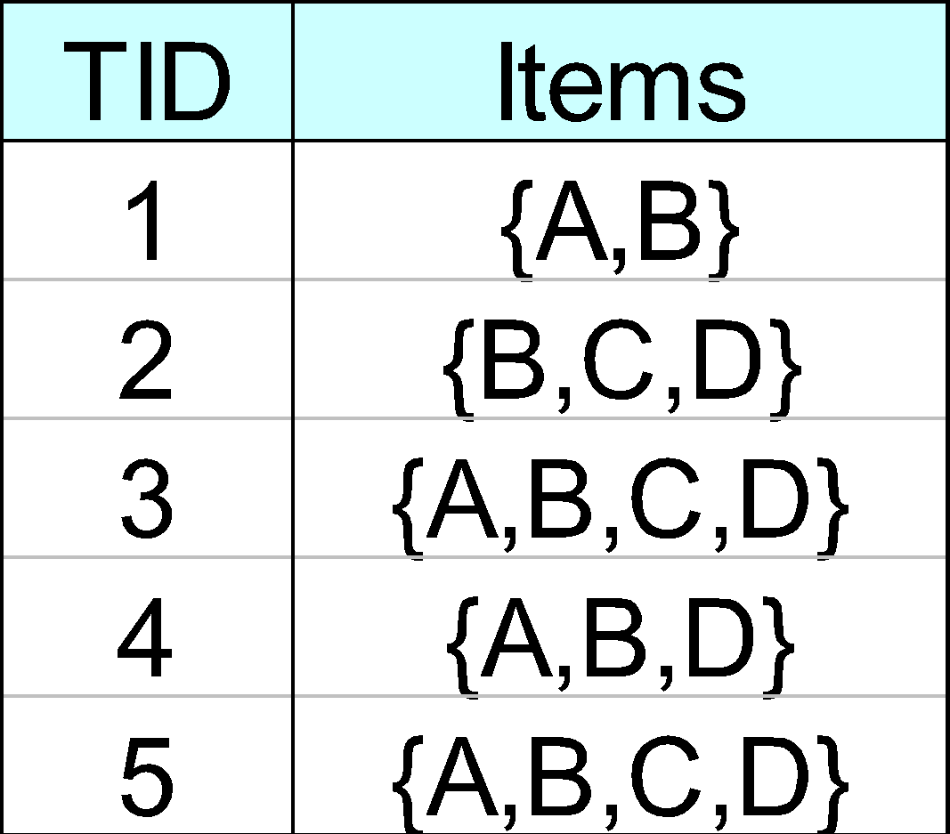
Closed Itemset
An itemset X is closed if none of its immediate supersets has the same support as the itemset X.
X is not closed if at least one of its immediate supersets has support count as X.

Slide 61
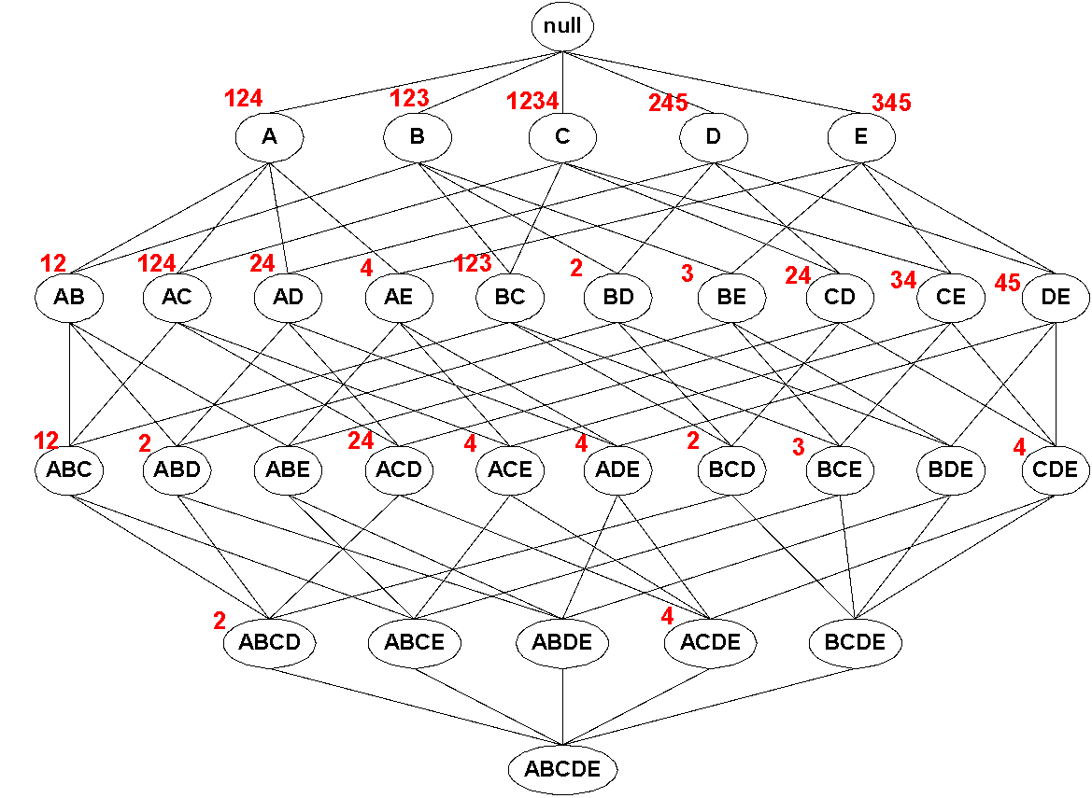
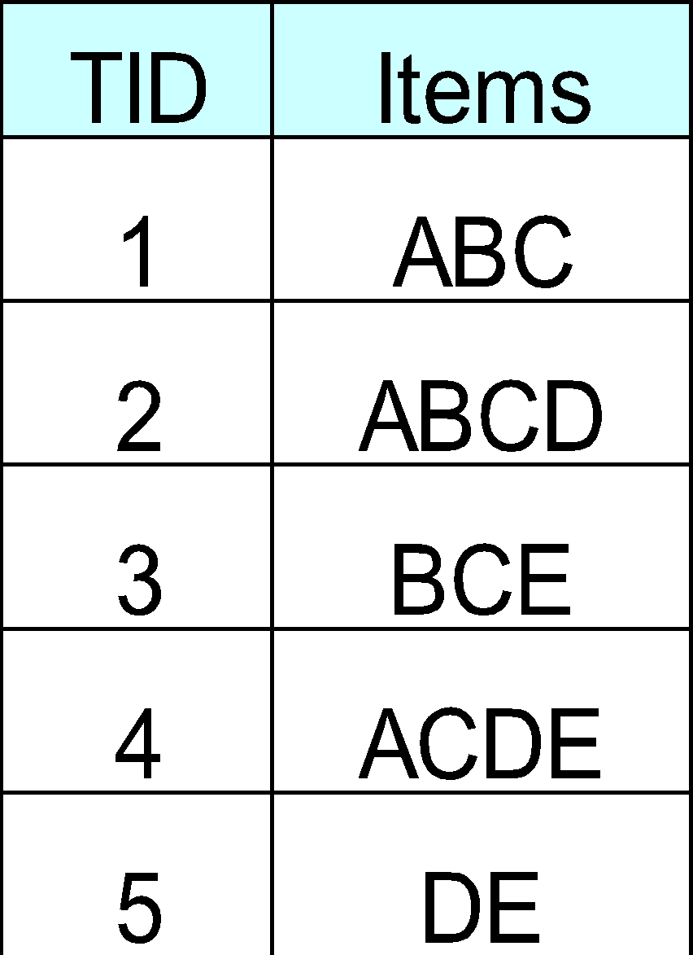
Maximal vs Closed Itemsets
Transaction Ids
Not supported by any transactions

Slide 62
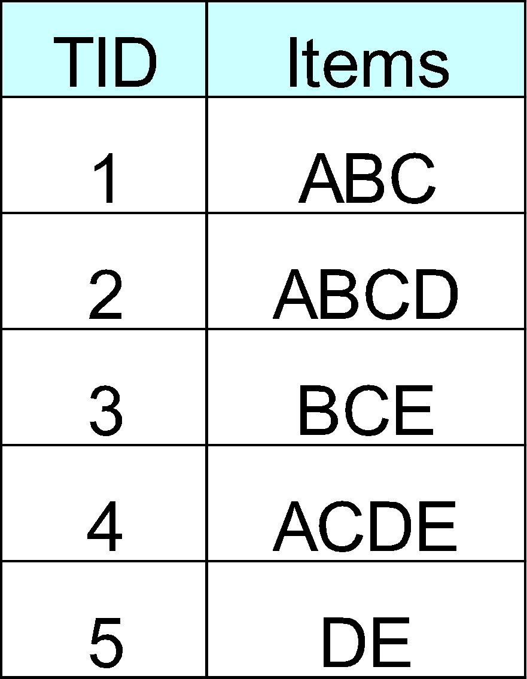
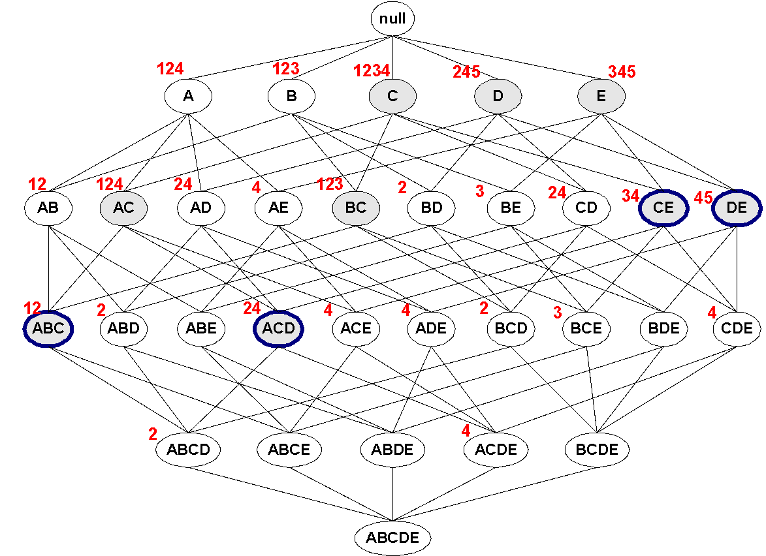
Maximal Frequent vs Closed Frequent Itemsets
Minimum support = 2
Closed but not maximal
Closed and maximal
# Closed frequent = 9
# Maximal freaquent = 4

Slide 63
What are the Closed Itemsets in this Data?
(A1-A10)
(B1-B10)
(C1-C10)

Slide 64
Example 1
Items
 | A | B | C | D | E | F | G | H | I | J
1
2
3
4
5
6
7
8
9
10
Itemsets | Support (counts) | Closed itemsets
{C} | 3
{D} | 2
{C,D} | 2
Transactions

Slide 65
Example 1
Items
 | A | B | C | D | E | F | G | H | I | J
1
2
3
4
5
6
7
8
9
10
Itemsets | Support (counts) | Closed itemsets
{C} | 3 | ✔
{D} | 2
{C,D} | 2 | ✔
Transactions

Slide 66
Example 2
Items
 | A | B | C | D | E | F | G | H | I | J
1
2
3
4
5
6
7
8
9
10
Itemsets | Support (counts) | Closed itemsets
{C} | 3
{D} | 2
{E} | 2
{C,D} | 2
{C,E} | 2
{D,E} | 2
{C,D,E} | 2
Transactions

Slide 67
Example 2
Items
 | A | B | C | D | E | F | G | H | I | J
1
2
3
4
5
6
7
8
9
10
Itemsets | Support (counts) | Closed itemsets
{C} | 3 | ✔
{D} | 2
{E} | 2
{C,D} | 2
{C,E} | 2
{D,E} | 2
{C,D,E} | 2 | ✔
Transactions

Slide 68
Example 3
Items
 | A | B | C | D | E | F | G | H | I | J
1
2
3
4
5
6
7
8
9
10
Closed itemsets: {C,D,E,F}, {C,F}
Transactions

Slide 69
Example 4
Items
 | A | B | C | D | E | F | G | H | I | J
1
2
3
4
5
6
7
8
9
10
Closed itemsets: {C,D,E,F}, {C}, {F}
Transactions

Slide 70

Maximal vs Closed Itemsets

Slide 71



Example question
Given the following transaction data sets (dark cells indicate presence of an item in a transaction) and a support threshold of 20%, answer the following questions
DataSet: A
Data Set: B
Data Set: C
What is the number of frequent itemsets for each dataset? Which dataset will produce the most number of frequent itemsets?
Which dataset will produce the longest frequent itemset?
Which dataset will produce frequent itemsets with highest maximum support?
Which dataset will produce frequent itemsets containing items with widely varying support levels (i.e., itemsets containing items with mixed support, ranging from 20% to more than 70%)?
What is the number of maximal frequent itemsets for each dataset? Which dataset will produce the most number of maximal frequent itemsets?
What is the number of closed frequent itemsets for each dataset? Which dataset will produce the most number of closed frequent itemsets?

Slide 72
Pattern Evaluation
Association rule algorithms can produce large number of rules
Interestingness measures can be used to prune/rank the patterns
In the original formulation, support & confidence are the only measures used

Slide 73
Computing Interestingness Measure
Given X → Y or {X,Y}, information needed to compute interestingness can be obtained from a contingency table
Contingency table
 | Y | Y
X | f₁₁ | f₁₀ | f₁₊
X | f₀₁ | f₀₀ | f_{o+}
 | f₊₁ | f₊₀ | N
f₁₁: support of X and Y f₁₀: support of X and Y f₀₁: support of X and Y f₀₀: support of X and Y
Used to define various measures
support, confidence, Gini, entropy, etc.

Slide 74

Drawback of Confidence
Customers | Tea | Coffee | …
C1 | 0 | 1 | …
C2 | 1 | 0 | …
C3 | 1 | 1 | …
C4 | 1 | 0 | …
…
Association Rule: Tea → Coffee
Confidence ≅ P(Coffee|Tea) = 150/200 = 0.75
Confidence > 50%, meaning people who drink tea are more likely to drink coffee than not drink coffee
So rule seems reasonable

Slide 75
Drawback of Confidence
 | Coffee | Coffee
Tea | 150 | 50 | 200
Tea | 650 | 150 | 800
 | 800 | 200 | 1000
Association Rule: Tea → Coffee
Confidence= P(Coffee|Tea) = 150/200 = 0.75
but P(Coffee) = 0.8, which means knowing that a person drinks tea reduces the probability that the person drinks coffee!
Note that P(Coffee|Tea) = 650/800 = 0.8125

Slide 76

Drawback of Confidence
Customers | Tea | Honey | …
C1 | 0 | 1 | …
C2 | 1 | 0 | …
C3 | 1 | 1 | …
C4 | 1 | 0 | …
…
Association Rule: Tea → Honey Confidence ≅ P(Honey|Tea) = 100/200 = 0.50
Confidence = 50%, which may mean that drinking tea has little influence whether honey is used or not
So rule seems uninteresting
But P(Honey) = 120/1000 = .12 (hence tea drinkers are far more likely to have honey

Slide 77
Measure for Association Rules
So, what kind of rules do we really want?
Confidence(X → Y) should be sufficiently high
To ensure that people who buy X will more likely buy Y than not buy Y
Confidence(X → Y) > support(Y)
Otherwise, rule will be misleading because having item X actually reduces the chance of having item Y in the same transaction
Is there any measure that capture this constraint?
Answer: Yes. There are many of them.

Slide 78
Statistical Relationship between X and Y
The criterion confidence(X → Y) = support(Y)
is equivalent to:
P(Y|X) = P(Y)
P(X,Y) = P(X) × P(Y) (X and Y are independent)
If P(X,Y) > P(X) × P(Y) : X & Y are positively correlated
If P(X,Y) < P(X) × P(Y) : X & Y are negatively correlated

Slide 79

Measures that take into account statistical dependence
lift is used for rules while interest is used for itemsets

Slide 80
Example: Lift/Interest
 | Coffee | Coffee
Tea | 150 | 50 | 200
Tea | 650 | 150 | 800
 | 800 | 200 | 1000
Association Rule: Tea → Coffee
Confidence= P(Coffee|Tea) = 0.75
but P(Coffee) = 0.8
Interest = 0.15 / (0.2×0.8) = 0.9375 (< 1, therefore is negatively associated)
So, is it enough to use confidence/Interest for pruning?

Slide 81

There are lots of measures proposed in the literature

Slide 82


Comparing Different Measures
10 examples of contingency tables:
Rankings of contingency tables using various measures:

Slide 83

Property under Inversion Operation
Transaction 1
.
.
.
.
.
Transaction N

Slide 84
Property under Inversion Operation
Transaction 1
.
.
.
.
.
Transaction N
Correlation: -0.1667 -0.1667
IS/cosine 0.0 0.825

Slide 85

Property under Null Addition
Invariant measures:
cosine, Jaccard, All-confidence, confidence
Non-invariant measures:
correlation, Interest/Lift, odds ratio, etc

Slide 86
Property under Row/Column Scaling
Grade-Gender Example (Mosteller, 1968):
 | Male | Female
High | 30 | 20 | 50
Low | 40 | 10 | 50
 | 70 | 30 | 100
 | Male | Female
High | 60 | 60 | 120
Low | 80 | 30 | 110
 | 140 | 90 | 230
2x
3x
Mosteller: Underlying association should be independent of the relative number of male and female students in the samples
Odds-Ratio ((f₁₁₊f₀₀ )/(f₁₀₊f₁₀)) has this property
has this property

Slide 87
Property under Row/Column Scaling
Relationship between Mask use and susceptibility to Covid:
 | Covid-Positive | Covid-Free
Mask | 20 | 30 | 50
No-Mask | 40 | 10 | 50
 | 60 | 40 | 100
 | Covid-Positive | Covid-Free
Mask | 40 | 300 | 340
No-Mask | 80 | 100 | 180
 | 120 | 400 | 520
2x
10x
Mosteller: Underlying association should be independent of the relative number of Covid-positive and Covid-free subjects
Odds-Ratio ((f₁₁₊f₀₀ )/(f₁₀₊f₁₀)) has this property

Slide 88

Different Measures have Different Properties

Slide 89
Simpson’s Paradox
Observed relationship in data may be influenced by the presence of other confounding factors (hidden variables)
Hidden variables may cause the observed relationship to disappear or reverse its direction!
Proper stratification is needed to avoid generating spurious patterns

Slide 90
Simpson’s Paradox
Recovery rate from Covid
Hospital A: 80%
Hospital B: 90%
Which hospital is better?

Slide 91
Simpson’s Paradox
Recovery rate from Covid
Hospital A: 80%
Hospital B: 90%
Which hospital is better?
Covid recovery rate on older population
Hospital A: 50%
Hospital B: 30%
Covid recovery rate on younger population
Hospital A: 99%
Hospital B: 98%

Slide 92
Simpson’s Paradox
Covid-19 death: (per 100,000 of population)
County A: 15
County B: 10
Which state is managing the pandemic better?

Slide 93
Simpson’s Paradox
Covid-19 death: (per 100,000 of population)
County A: 15
County B: 10
Which state is managing the pandemic better?
Covid death rate on older population
County A: 20
County B: 40
Covid death rate on younger population
County A: 2
County B: 5

Slide 94

Effect of Support Distribution on Association Mining
Many real data sets have skewed support distribution
Few items with high support
Many items with low support
Support distribution of a retail data set
Rank of item (in log scale)

Slide 95
Effect of Support Distribution
Difficult to set the appropriate minsup threshold
If minsup is too high, we could miss itemsets involving interesting rare items (e.g., {caviar, vodka})
If minsup is too low, it is computationally expensive and the number of itemsets is very large

Slide 96

Cross-Support Patterns
A cross-support pattern involves items with varying degree of support
Example: {caviar,milk}
How to avoid such patterns?
caviar
milk

Slide 97


A Measure of Cross Support

Slide 98
Confidence and Cross-Support Patterns
Observation:
conf(caviar→milk) is very high
but
conf(milk→caviar) is very low
Therefore,
min( conf(caviar→milk), conf(milk→caviar) ) is also very low
caviar
milk

Slide 99

H-Confidence

Slide 100

H-Confidence …

Slide 101

Cross Support and H-confidence

Slide 102

Cross Support and H-confidence …

Slide 103

Properties of Hypercliques

Slide 104

Properties of Hypercliques …

Slide 105

Example Applications of Hypercliques
Hypercliques are used to find strongly coherent groups of items
Words that occur together in documents
Proteins in a protein interaction network
In the figure at the right, a gene ontology hierarchy for biological process shows that the identified proteins in the hyperclique (PRE2, …, SCL1) perform the same function and are involved in the same biological process

